Slide 1
SESSION 1
CONSEQUENCES OF E-CIGARETTE USE
© 2019 The University of Texas Health Science Center at Houston. All rights are reserved. CATCH® is a registered trademark of The Regents of the University of California.
Notes:
Suggested length: 35 minutes

Slide 2
WHAT IS CATCH MY BREATH?
Four 35-minute sessions that will give you crucial information about e-cigarettes so that you can make your own informed choices.
Peer Group Facilitators will lead you in activities where you will:
Identify the health hazards of e-cigarettes.
Discuss why people begin using e-cigarettes.
Determine positive alternatives to using e-cigarettes.
Recognize the advertising methods the industry uses to make you want to try e-cigarettes.
Practice ways to resist pressure to use e-cigarettes.
Make your own slogan and warning label for e-cigarettes.
Notes:
Introduction (3-5 min.)
Introduce overview of CATCH My Breath includes four 35 min. sessions with crucial information about e-cigarettes. Peer Group Facilitators will lead you in activities where you will:
Identify the health hazards of using e-cigarettes.
Discuss why people begin using e-cigarettes.
Determine positive alternatives to using e-cigarettes.
Recognize the advertising methods e-cigarette companies use to make you want to try e-cigarettes.
Practice ways to resist pressure to use e-cigarettes.
Make your own advertising slogan addressing a common misconception about the product.

Slide 3
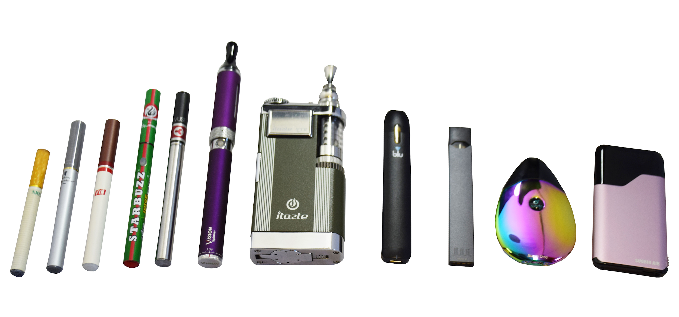
LESS HARM DOES NOT MEAN HARMLESS
Cigarettes and other tobacco products contain nicotine and are extremely harmful to the body
Although e-cigarettes have fewer toxic chemicals than cigarettes, they are still harmful!
Notes:
Image source: https://www.health.state.mn.us/communities/tobacco/ecigarettes/index.html

Slide 4
WHAT HAVE YOU HEARD, SEEN, OR THOUGHT ABOUT E-CIGARETTES?
Record your response to the question above on your index card or paper.
Notes:
Direct Instruction (10 min.)
Distribute an index card or square of paper to each student.
Ask students to record responses to the following question on their index card:
What have you heard, seen, or thought about e-cigarettes? (Stress that there are no wrong answers and they do NOT need to include their name on the index card)
Collect the index cards.
Read responses aloud to the class.
List students’ answers on the board.

Slide 5
THE DENOBLE FILES: E-CIGARETTES
Notes:
Show the video: https://youtu.be/tpfbBm7IofQ. The DeNoble Files: E-cigarettes? (1:18 min).

Slide 6
VAPOR AEROSOL
E-cigarette “vapor” is NOT water vapor. It is made up of tiny particles containing nicotine and harmful toxic chemicals.
Notes:
Share this fact about e-cigarettes with students: e-cigarette “vapor” is NOT water vapor. It is an aerosol made up of ultrafine particles containing nicotine and harmful chemicals.
Explain to students that an aerosol is a suspension of tiny particles of liquid, solid or both within a gas. as opposed to water vapor that is a substance (in this case water) in its gaseous phase

Slide 7
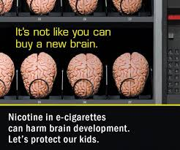
NICOTINE IS HARMFUL
Nearly ALL e-cigarettes (and all tobacco) contains nicotine
Nicotine causes addiction to e-cigarettes making it really difficult to stop using them
Notes:
Explain: Nearly all e-cigarettes (and all tobacco) contain nicotine (including JUUL) which is a HIGHLY addictive chemical.
As a teen, your brain is still developing, making it easier for you to get addicted to nicotine.
Addiction is a brain disease. This means once you start using nicotine-based products like e-cigarettes (or any kind of tobacco) your brain gets rewired and restructured. This makes it hard to quit using any product that contains nicotine.

Slide 8
JUUL: STILL AN E-CIGARETTE
Just like other e-cigarettes, JUULing involves inhaling dangerous chemicals.
All JUUL pods contain nicotine.
JUUL claims each pod contains as much nicotine as a pack of cigarettes (about 200 puffs).
Notes:
Explain (2-5 mins) that there is a large amount of nicotine in each JUUL pod. JUUL is the most popular brand of e-cigarette in the US. These devices are not any different than other e-cigarettes. JUUL is often referred to as the “iPhone” of e-cigarettes because it is easy to use and has a sleek design and it is a well-known brand.
Note for Teacher: it’s important to explain to the students that you and the administration at your school know what JUULs are and will not accept the use of them in or on school property. For more information on JUUL to prepare you for this topic, visit: https://www.tobaccofreekids.org/assets/factsheets/0394.pdf
Image source: https://twitter.com/JUULvapor/status/993581260340649985

Slide 9
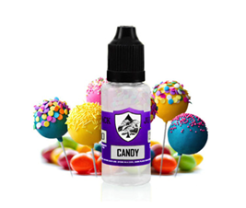
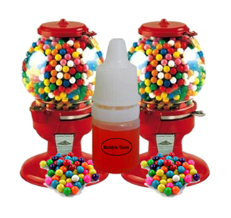
E-CIGARETTE FLAVORS
Hawaiian Punch
Gummy bears
S’mores
Skittles
Cotton candy
Sweet Tarts
Fruit Loops
Banana Split
Cool Cucumber
Who are advertisers trying to appeal to with these candy flavors?
Notes:
Explain there are more than 8,000 e-cigarette flavors on the market and 99% of them contain nicotine. E-cigarette companies claim to use flavors to help adults quit, but they are the reason most kids get hooked on nicotine and tobacco products.

Slide 10
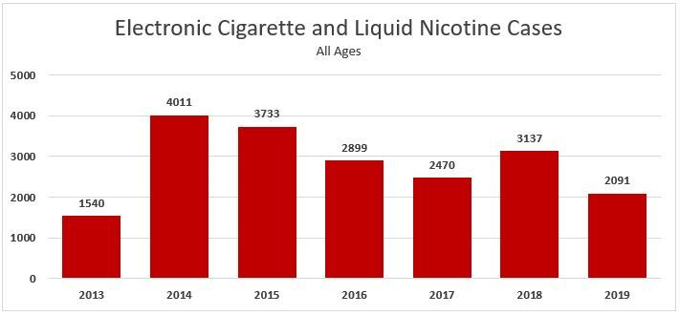
THE E-CIGARETTE FACTS
Notes:
Share the facts:
Most sweet, candy, and fruit-flavored E-cigarettes contain nicotine.
As of September 30th 2019, poison control centers 2019 have managed 3,583 exposure cases related to e-cigarettes and e-liquid
Nicotine liquid (AKA e-juice) is very harmful and possibly fatal when ingested.
Sources:
E-Cigarettes and Liquid Nicotine. (2019, June 30). Retrieved July 18, 2019, from https://aapcc.org/track/ecigarettes-liquid-nicotine
Kamboj, A., Spiller, H. A., Casavant, M. J., Chounthirath, T., & Smith, G. A. (2016). Pediatric exposure to e-cigarettes, nicotine, and tobacco products in the United States. Pediatrics, 137(6), e20160041.
Nayir, E., Karacabey, B., Kirca, O., & Ozdogan, M. (2016). Electronic cigarette (e-cigarette). Journal of Oncological Science, 2(1), 16-20.
Chatham-Stephens, K., Law, R., Taylor, E., Kieszak, S., Melstrom, P., Bunnell, R., ... & Foster, H. (2016). Exposure Calls to US Poison Centers Involving Electronic Cigarettes and Conventional Cigarettes—September 2010–December 2014. Journal of medical toxicology, 12(4), 350-357..
Chen, B. C., Bright, S. B., Trivedi, A. R., & Valento, M. (2015). Death following intentional ingestion of e-liquid. Clinical toxicology, 53(9), 914-916.

Slide 11
DRUM ROLL PLEASE…
Announce Peer Group Facilitators and group assignments.
Assemble into your numbered groups.
Notes:
Announce Peer Group Facilitators and group assignments.
Ask students to assemble into their groups.
CASEL Competencies Covered
Social awareness - perspective taking, respect for others
Relationship skills - communication, social engagement, relationship building, teamwork

Slide 12
ACTIVITY 1: E-CIGARETTE INGREDIENT INVESTIGATION
Notes:
Activity 1: E-cigarette Ingredient Investigation (10-15 min.)
Ask Peer Group Facilitators to turn to Session 1, Activity 1: E-cigarette Ingredient Investigation
CASEL Competencies Covered
Social awareness - perspective taking, respect for others
Relationship skills - communication, social engagement, relationship building, teamwork

Slide 13
ACTIVITY 1: E-CIGARETTE INGREDIENT INVESTIGATION
Each group will read through your assigned chemical listed on the worksheet
In your groups:
Read the description of each chemical taken from the material data safety sheet to group
As you read the information about the ingredients aloud to your group, record their reactions to the information.
Each group should complete the “Other Substances” section
Notes:
Activity 1: E-cigarette Ingredient Investigation (10-15 min.)
Ask Peer Group Facilitators to record their group’s reactions to their assigned chemical on the sheet.
Note: It is okay if more than one group has the same ingredient.
Explain that although e-cigarettes create a vapor/aerosol, they do NOT contain any water. The e-liquid is made of lots of different chemicals and today we will explore those. The government issues something called a Material Data Safety (MSD) sheet which give information about the chemical and it’s harmful side-effects.
CASEL Competencies Covered
Social awareness - perspective taking, respect for others
Relationship skills - communication, social engagement, relationship building, teamwork

Slide 14
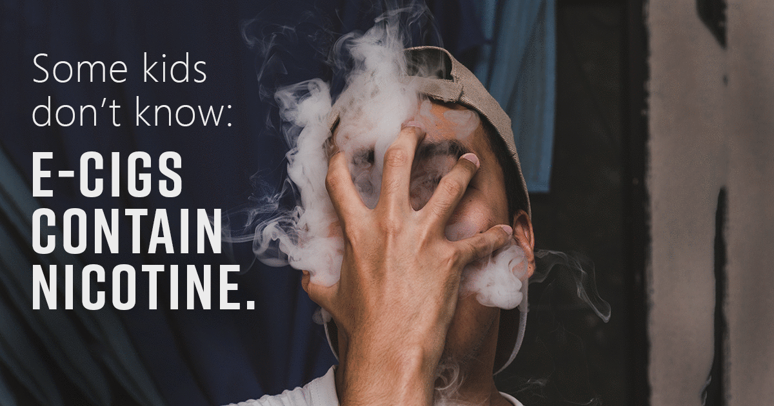
ACTIVITY 1: E-CIGARETTE INGREDIENT INVESTIGATION
Please summarize what you found out about:
Nicotine
Formaldehyde
Propylene glycol
8,000+ flavor chemicals
Notes:
Review the responses given by each group
CASEL Competencies Covered
Social awareness - perspective taking, respect for others
Relationship skills - communication, social engagement, relationship building, teamwork

Slide 15
ACTIVITY 2: NEGATIVE CONSEQUENCES OF USING E-CIGARETTES
On your index card or paper:
List negative consequences of using e-cigarettes
Include, but think beyond health consequences
Think about how e-cigarettes could affect social relationships, family relationships, personal identity, and goals
After 3 minutes, Peer Group Facilitators will collect the index cards and read them aloud to the group
Notes:
Activity 2: Negative Consequence of Using E-cigarettes (5-7 minutes)
Distribute an index card or square of paper to each student.
Ask each student to write down what they think are negative consequences (or side-effects) of using e-cigarettes
Explain these can be related to your health, but they should also think about their family, friends, and pocketbook.
CASEL Competencies Covered
Responsible decision-making - identifying problems, analyzing situations, evaluating, reflecting, ethical responsibility
Self-awareness - identifying emotions, accurate self-perception, self-confidence
Relationship skills - communication, social engagement

Slide 16
ACTIVITY 2: NEGATIVE CONSEQUENCES OF USING E-CIGARETTES
Possible Answers
Costs a lot of money, about $50 to get started
Long-term addiction
Aerosol contains toxic chemicals
Poor influence on younger siblings
Get in trouble at school or at home (parents)
Get suspended from school activities (sports)
Get in trouble with the law
Harms babies
Harms your body (organ damage)
Nausea, dry mouth, dizziness, coughing/wheezing, worsens/trigger asthma
Ingesting e-liquid can be FATAL
Notes:
Review the answers students gave. Write them on a whiteboard or space where all students can see the collection of responses.
CASEL Competencies Covered
Responsible decision-making - identifying problems, analyzing situations, evaluating, reflecting, ethical responsibility
Self-awareness - identifying emotions, accurate self-perception, self-confidence
Relationship skills - communication, social engagement
Citation:
National Academies of Sciences, Engineering, and Medicine. (2018). Public health consequences of e-cigarettes. National Academies Press.

Slide 17
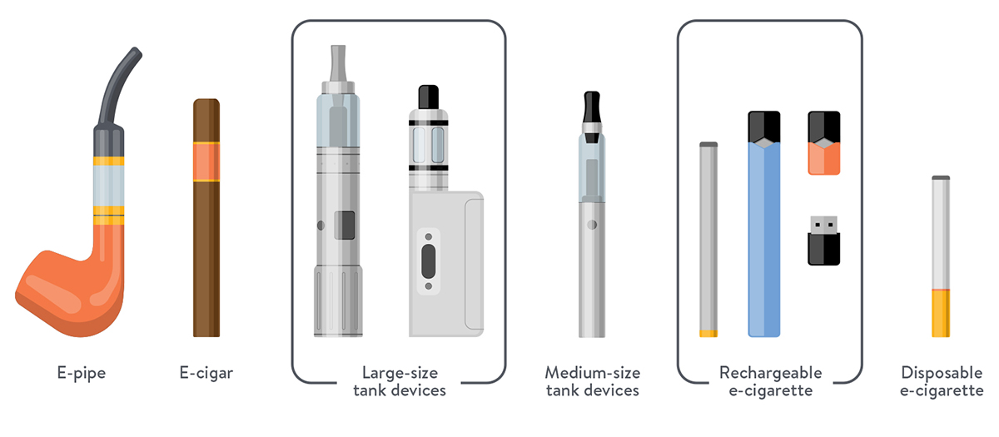
WHAT NEW INFORMATION HAVE YOU GAINED?
Notes:
Closing (3-5 min.)
Review the list of what students had heard, seen or thought about e-cigarettes.
Ask: What new Information have you gained?
Image credit: https://www.allegropediatrics.com/blog/blog/from-our-docs/e-cigarette-qanda-with-dr-spanier
All photos unless otherwise cited were sourced from Pixabay.

