Slide 1
SESSION 2
MAKING OUR OWN CHOICES
© 2019 The University of Texas Health Science Center at Houston. All rights are reserved.
CATCH® is a registered trademark of The Regents of the University of California.

Slide 2

THE REAL COST: NICOTINE
Notes:
Introduction 3-5 minutes
Watch “The Fallout”(30 sec) and discuss impression with class.
Link: https://www.youtube.com/watch?v=LcymD3nh_OY

Slide 3

KNOW THE RULES AND LAWS
    All states have restrictions around the sale, purchase, or use of e-cigarettes or nicotine containers to a minor
    Visit the Public Health Law Center’s website to find out the specific laws in your state.
Notes:
Explain: All states have restrictions around the sale, purchase, or use of e-cigarettes or nicotine containers to a minor. Visit the website to find the specific restrictions and age requirements for your state. Most states require you to be at least 18, though more states are now increasing the age to 21 in order to purchase.
Share your school/district policy about e-cigarettes as well as any consequences the students might incur if they use e-cigarettes on school property.
Link: http://www.publichealthlawcenter.org/resources/us-e-cigarette-regulations-50-state-review
*Click link, click your state on the map, and scroll to “What restrictions are in place for retail or youth access?” for age restrictions and other information.*

Slide 4
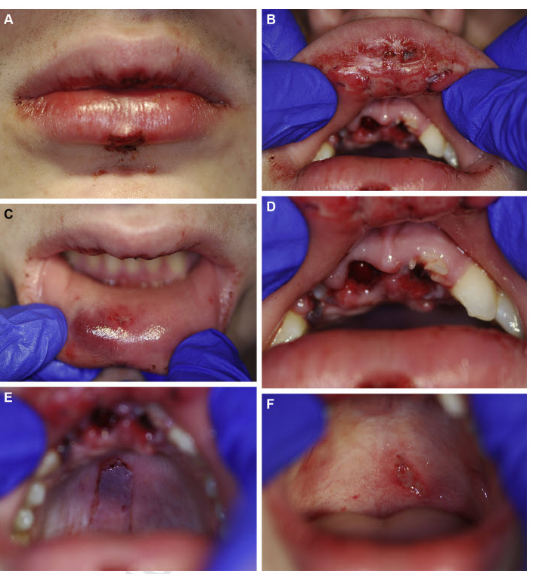
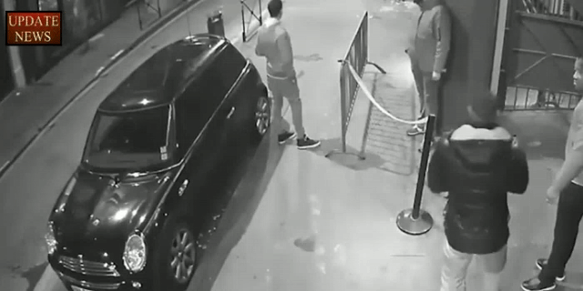
E-CIGARETTES ARE KNOWN TO OCCASIONALLY EXPLODE IN YOUR POCKET OR YOUR MOUTH…
Figure 1. Initial presentation. A, extraoral view of lips. B, Upper labial mucosa. C, Lower labial mucosa.
D, Teeth involved. E, Hard palate. F, Soft palate.
Roger et al. Oral Trauma After Explosion of E-Cigarette. J Oral Maxillofac Surg 2016
Notes:
Explain: E-cigarettes are known to occasionally explode in your pocket or your mouth.
While there have been no reports of JUUL and other USB e-cigarette devices exploding, several other battery-operated e-cigarette devices have the potential to explode, and have on multiple occasions. There have been multiple reports of battery-operated e-cigarettes exploding either due to user or manufacturer error.

Slide 5
TAKE A GUESS
What percentage of middle school students
have smoked e-cigarettes in the past 30 days?
What percentage of high school students
have smoked e-cigarettes in the past 30 days?
Notes:
Direct Instruction (5 min.)
A. Ask students to guess the following on scratch paper:
What percentage of middle school students have smoked e-cigarettes in the past 30 days?
What percentage of high school students have smoked e-cigarettes in the past 30 days?
B. Ask students to share their guesses.
CASEL Competency
Self-awareness - accurate self-perception
Social awareness - perspective-taking

Slide 6
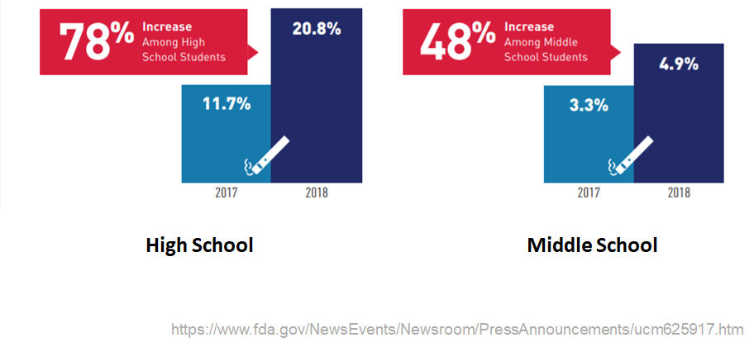
THE TRUTH
Notes:
Reveal: the actual numbers: 4.9% of middle schoolers and 20.8% of high-schoolers and have smoked an e-cigarette in the last 30 days.
Discuss: Most teenagers surveyed disapproved of e-cigarette use. Very few high schoolers, and even fewer middle school students, smoke e-cigarettes.
Ask: Are these numbers surprising? Why do you think students’ estimates are usually higher than the actual number? (possible answers: advertising, YouTube and social media, bragging, etc.)
CASEL Competency
Self-awareness - accurate self-perception
Social awareness - perspective-taking
*Note: Students often overestimate the number or people they think use e-cigarettes, just as they do with conventional cigarettes. By presenting facts about the teen prevalence of E-cigarette usage, students will understand that not “everybody does it.”
Data Source: Wang, T. W., Gentzke, A., Sharapova, S., Cullen, K. A., Ambrose, B. K., & Jamal, A. (2018). Tobacco Product Use Among Middle and High School Students — United States, 2011–2017. MMWR. Morbidity and Mortality Weekly Report, 67(22), 629-633. doi:10.15585/mmwr.mm6722a3

Slide 7

SMALL GROUPS, ASSEMBLE!
Notes:
Work Time 20-25 minutes
Ask the students to assemble into their peer-facilitated groups.
CASEL Competencies Covered
Social Awareness - perspective taking, appreciating diversity, respect for others
Self-management - impulse control, stress management, self-discipline
Relationship skills - communication, social engagement, relationship-building

Slide 8
ACTIVITY 1: WHY DO IT?
On the front of your index card, record responses to the following question:
  Why might kids your age experiment with e-cigarettes?
On the back of your index card, record responses to the following question:
  What are some positive things kids your age can do instead of using e-cigarettes?
Notes:
Activity 1: Why Do It? (10 min.)
Distribute an index card or cut up paper square to each student.
Ask students to independently record responses to the following question on the front side of their index card:
Why might young people experiment with E-cigarettes?
On the back side, record responses to the following question:
What are some positive things young people can do instead of using E-cigarettes?
Ask Peer Group Facilitators to collect the index cards and read the reasons for use and positive alternatives aloud to their group
Ask Peer group facilitators to share 2-3 of the reasons for use and positive alternatives with the whole class.
CASEL Competencies Covered
Social Awareness - perspective taking, appreciating diversity, respect for others
Self-management - impulse control, stress management, self-discipline
Relationship skills - communication, social engagement, relationship-building

Slide 9
ACTIVITY 1: WHY DO IT?
Reasons to Try E-Cigarettes | Potential Positive Alternatives
If friends use e-cigarette | Be yourself. Help your friends learn about the harm of e-cigarette use. Figure out your passion and join a sports team or a club; invite friends to a movie; tell a joke.
If family members (parents/siblings) use e-cigarettes | Inform family members about the dangers of e-cigarette use. Try to institute changes at home requesting family members not smoking around you. Be the voice of reason.
The flavors look and smell tasty (varied flavouring especially mint, candy, fruit or chocolate. | Make your own smoothie with a variety of fruits and vegetables. Get a fresh-pressed juice. Eat or drink something with flavour you like. Indulge in healthier options with intriguing flavours.
Just Curious | Ask lots of questions and research the facts.
Less harmful than other forms of tobacco such as cigarettes | Help friends understand that although e-cigarettes are less harmful, they contain harmful toxins and cause addiction, a brain disease.
Notes:
Read: Example reasons for use and positive alternatives to the class
Data source: 2018 Morbidity and Mortality Weekly Review (Tsai, J., Walton, K., Coleman, B. N., Sharapova, S. R., Johnson, S. E., Kennedy, S. M., & Caraballo, R. S. (2018). Reasons for electronic cigarette use among middle and high school students—National Youth Tobacco Survey, United States, 2016. Morbidity and Mortality Weekly Report, 67(6), 196.)
Although e-cigarettes have the potential to benefit adult smokers if used as a complete substitute for combustible tobacco smoking , the use of any form of tobacco by adolescents is considered unsafe.
CASEL Competencies Covered
Social Awareness - perspective taking, appreciating diversity, respect for others
Self-management - impulse control, stress management, self-discipline
Relationship skills - communication, social engagement, relationship-building

Slide 10
ACTIVITY 2: JUST SAY ‘NO’
A refusal skill is something that can help you say “No” in a creative way
An exit strategy is a thoughtful way to get out of an uncomfortable situation
Notes:
Activity 2: Just Say ‘No’ (15 min.)
Explain Refusal skills are a set of skills designed to help people avoid participating in high-risk behaviors.
Exit strategies are pre-planned means of removing yourself from a situation that is likely to become difficult or unpleasant
CASEL Competencies Covered
Self-management - impulse control, self-discipline
Self-awareness - identifying emotions, self-confidence, self-efficacy
Social awareness - perspective-taking, respect for others
Relationship skills - communication, social engagement
Responsible decision-making - analyzing situations, evaluating, reflecting

Slide 11

ACTIVITY 2: JUST SAY ‘NO’
Use scratch paper to brainstorm smart
exit strategies/refusals to use when
offered an e-cigarette.
Notes:
Activity 2: Just Say ‘No’ (15 min.)
Ask: What are some situations and places in which you may be offered an e-cigarette? For example, in the school bathroom, locker room, in class, at at party.
Record situations and places on the board or scratch paper.
Explain: With your group, you will brainstorm smart exit strategies/refusals to use when offered an e-cigarette. Record the strategies on scratch paper.
CASEL Competencies
Self-management - impulse control, self-discipline
Self-awareness - identifying emotions, self-confidence, self-efficacy
Social awareness - perspective-taking, respect for others
Relationship skills - communication, social engagement
Responsible decision-making - analyzing situations, evaluating, reflecting

Slide 12
ACTIVITY 2: JUST SAY ‘NO’
Some examples of an exit strategy or response when you are offered an e-cigarette:
  Simply say "No thanks, I'm good."
  Hang out with non-smoking friends
  Suggest something else to do
  Give your reason for not wanting to use an e-cigarette
  Add some humor
Notes:
Review the strategies and responses your students developed.
Explain that there are no right or wrong answers for this - but each student should feel comfortable saying ‘No’ and removing themselves from that situation
CASEL Competencies Covered
Self-management - impulse control, self-discipline
Self-awareness - identifying emotions, self-confidence, self-efficacy
Social awareness - perspective-taking, respect for others
Relationship skills - communication, social engagement
Responsible decision-making - analyzing situations, evaluating, reflecting

Slide 13
ACTIVITY 2: JUST SAY ‘NO’
Form a circle.
Toss the ball to each other.
When you receive the ball, give a unique exit line or refusal to remain standing
Notes:
Game: Instruct students to form a circle.
Explain: We are going to see who has the best refusal skills. You will toss the ball (or a balled up piece of paper) to each other. When you receive the ball, you must give one refusal/exit strategy. You must come up with a unique refusal on the spot to remain standing. Can play until the last student standing wins, or as time permits.
Once each student has had a chance to give a refusal/exit strategy, have the students return to their seats for the next part of the lesson.
CASEL Competencies Covered
Self-management - impulse control, self-discipline
Self-awareness - identifying emotions, self-confidence, self-efficacy
Social awareness - perspective-taking, respect for others
Relationship skills - communication, social engagement
Responsible decision-making - analyzing situations, evaluating, reflecting

Slide 14
KNOWLEDGE IS POWER
Approximately 2 in 5 kids your age don’t think regular use of e-cigarettes is harmful.
Over 50% of kids your age don’t think there is nicotine in flavored e-cigarettes.
Sharing information is a better strategy than being mean or putting someone down because of their e-cigarette use.
Notes:
Explain: Most people who use e-cigarettes don’t have the information you have. Almost half of current users didn’t believe there were any health risks at all. Sharing information is a better strategy than being mean or harsh about someone’s e-cigarette use.
CASEL Competency Covered
Self-awareness - accurate self-perception
Social awareness - perspective taking
Relationship skills - communication
Information Source: Wang, T. W., Trivers, K. F., Marynak, K. L., O'Brien, E. K., Persoskie, A., Liu, S. T., & King, B. A. (2018). Harm perceptions of intermittent tobacco product use among US youth, 2016. Journal of Adolescent Health, 62(6), 750-753.

Slide 15
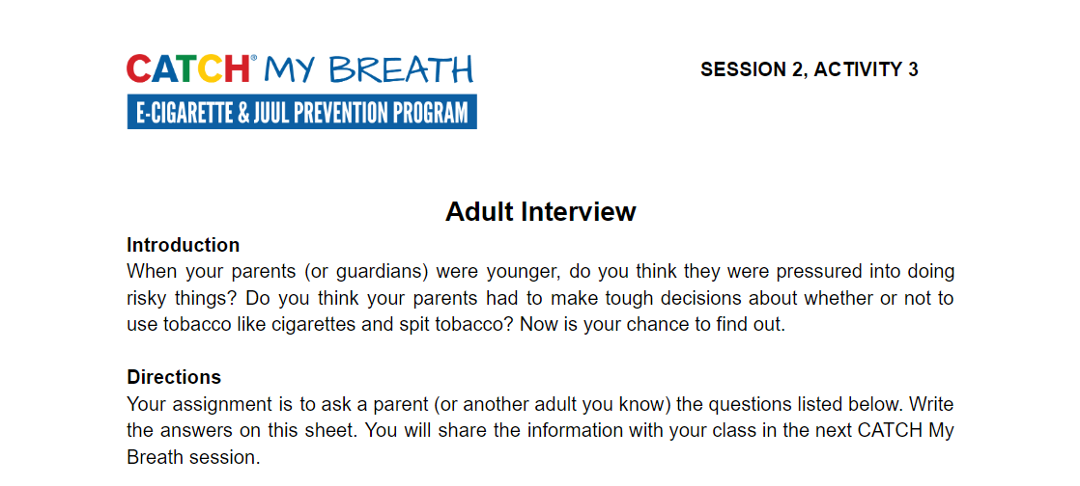
ASSIGNMENT: ADULT INTERVIEW
Notes:
Closing (1 min.)
Distribute one copy of the Session 2, Activity 3: Adult Interview worksheet to each student
Assignment Activity 3: Adult Interview.
Explain: You will quiz your parents (or another adult) on their e-cigarette knowledge. Bring the completed interview next session to discuss.
CASEL Competencies Covered
Self-awareness - self-confidence, self-efficacy
Self management - self-motivation, stress management, goal-setting, organizational skills
Social awareness - empathy, perspective-taking, appreciating diversity, respect for others
Relationship skills - communication, social engagement, relationship-building
All photos sourced from Pixabay unless otherwise cited.

