Slide 1
SESSION 3
DON’T LET THEM LIE AND WIN
© 2019 The University of Texas Health Science Center at Houston. All rights are reserved. CATCH® is a registered trademark of The Regents of the University of California.

Slide 2
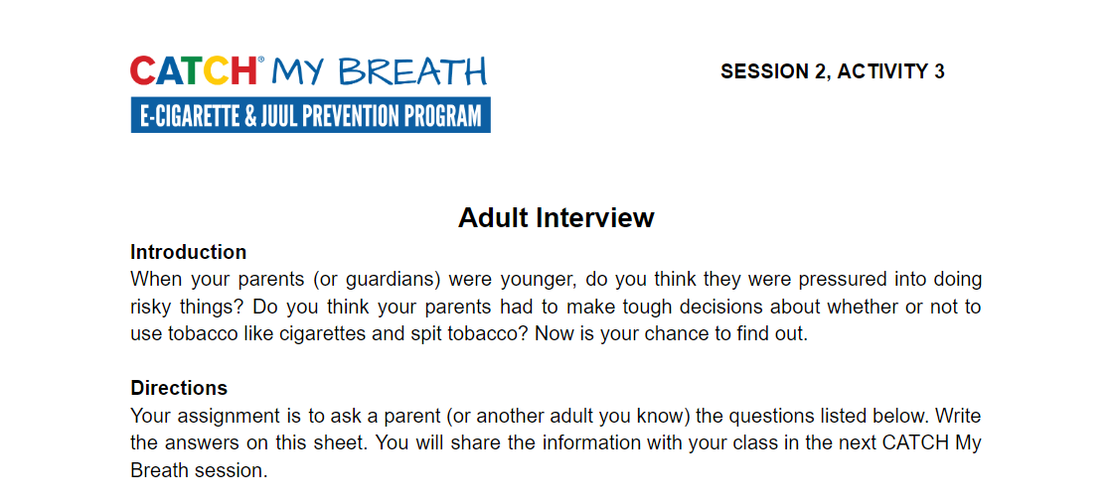
ADULT INTERVIEW DEBRIEF
Notes:
Introduction (5 min.)
Ask students to bring out Handout 2: Adult Interview. Ask the following questions:
•Did your adult give any good advice for resisting peer pressure?
•Did your adult know the facts about E-cigarettes?
CASEL Competencies Covered
Self management - self-motivation, stress management
Social awareness - empathy, perspective-taking, respect for others
Relationship skills - communication, social engagement, relationship-building

Slide 3
WHERE WOULD IT HAPPEN?
In what places or situations would you be most likely offered an e-cigarette?
Have you ever been around other kids who use e-cigarettes?
Notes:
Direct Instruction 5-10 minutes
Ask and discuss what places or situations your students could be offered an e-cigarette.
Give examples again here.
CASEL Competencies Covered
Relationship skills - social engagement
Responsible decision-making - analyzing situations, evaluating, reflecting

Slide 4
PEERS UNDER PRESSURE
You might feel pressure from your peers to try an e-cigarette, but….
MOST pressure comes from advertisements on TV, movies, magazines and the internet.
Notes:
Explain: Peers can directly pressure you to try e-cigarettes by offering you one, or may indirectly pressure you simply by smoking around you. Most of the pressure and curiosity to try e-cigarettes, however, has been created by advertisements.
CASEL Competencies Covered
Self-awareness - identifying emotions, accurate self-perception, self-confidence
Self-management - impulse control, self-discipline, self-motivation
Relationship skills - resisting in appropriate social pressure

Slide 5
ADS ALL AROUND YOU
Advertising is designed to pressure or convince you to buy products.
E-cigarette companies want you to try e-cigarettes and get addicted to nicotine.
They want your money, so the big companies make e-cigarettes look delicious, cool, fun and glamorous.
They don’t tell you the negative information.
Notes:
Remind students that E-cigarette companies want you to buy and become addicted to their products so they can make money.
CASEL Competencies Covered
Self-awareness - identifying emotions, accurate self-perception, self-confidence
Self-management - impulse control, self-discipline, self-motivation
Relationship skills - resisting in appropriate social pressure

Slide 6
DID YOU KNOW…
$9.5 billion is spent every year on tobacco and e-cigarette advertising
That’s more than $26 million every day, or more than $1 million every hour
About $29 for every person (adults and children) in the U.S per year!
Notes:
Share the statistic: $9.5 billion is spent every year on tobacco and e-cigarette advertising, social media and promotion—more than $26 million every day, or more than $1 million every hour.

Slide 7
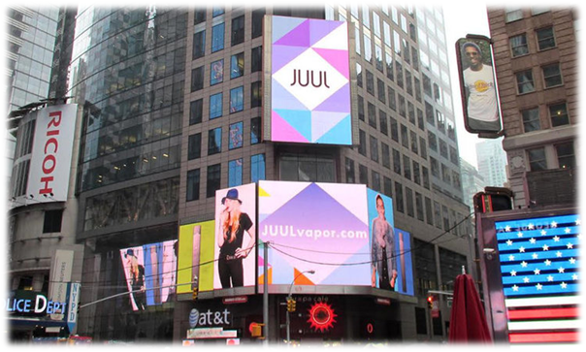
WHERE DOES THE MONEY COME FROM?
How can tobacco companies spend billions on advertising?
Notes:
Ask: How are tobacco companies able to afford to spend billions annually on advertising? (Click once to show answer)
Explain: Many of their customers are addicted to their products like e-cigarettes and regular cigarettes. The customers buy A LOT of e-cigarettes and regular cigarettes and the money is used to pay for advertising.
Review: Don’t forget that much of the social media (Instagram, Snapchat) and YouTube ads you see are paid for by the industry! In reality, only a very small percentage of teens use e-cigarettes.
Image Source: https://www.spencer-pederson.com/work-1/2017/2/23/juul-go-to-market

Slide 8
APPEALING TO ALL TYPES
Companies use a technique called an appeal which help to grab your attention and persuade you to buy or do something.
Common appeals used by the e-cigarette and tobacco industry are:
Health
Flavor
Social Life
Celebrity
Freedom
Sports
Masculinity/Femininity
Glamor/Beauty
Notes:
Explain: Companies use a technique called an appeal which help to grab your attention and persuade you to buy or do something.
Share: The e-cigarette industry uses many appeals, but the following are the most common:
Health - using the product will help you live a healthier lifestyle or be a healthier person
Flavor - the product tastes good so therefore it is safe for you to use
Social Life - using the product will help you feel more included, respected, and accepted by your friends and other people you might want to be friends with
Celebrity - using or buying this product will make you more like your favorite celebrity or movie star OR you could see a celebrity using the product and because they use it, you feel it is safe and okay for you to use as well
Freedom - the idea that using their product will allow you to be free
Sports - if you use the product, you will be better at sports, and more like your favorite professional athletes you could see a sports star using the product and because they use it, you feel it is safe and okay for you to use as well
Masculinity/Femininity - this gets at the idea that you might want to be a perfect boy or girl. They want you to think that if you use their product you will be more attractive and wanted by other people
Glamor/Beauty - these products appear to be perfect and will help you get to that stage too.

Slide 9
TYPES OF ADVERTISING
Direct Advertising
Advertising that is obviously paid for by the tobacco and e-cigarette industry
Examples: billboards, TV ads, internet banner ads, radio ads, magazine ads
Notes:
2. Direct Instruction (5-10 min.)
A. Explain the two types of advertising: Direct and Indirect
Direct advertising: clearly paid for by the tobacco and e-cigarette industry (billboards, television, internet, radio, magazine ads)
Indirect advertising: Tries to disguise the fact that it’s an ad.

Slide 10
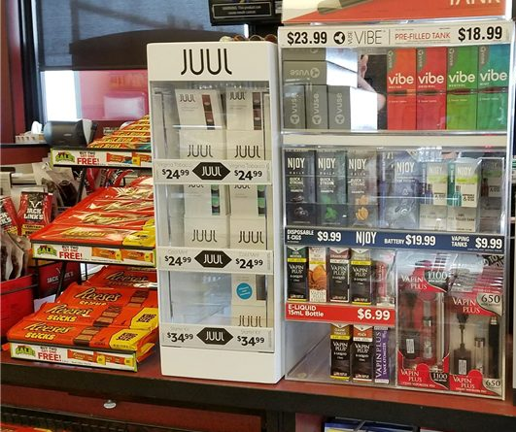
DIRECT ADVERTISING EXAMPLES
Notes:
Explain how the e-cigarettes are being sold right next to candy, which is typically appealing for children and young adults.

Slide 11
TYPES OF ADVERTISING
Indirect Advertising: hides that it’s an ad
Social Media: Big tobacco companies pay people to post about tobacco and e-cigarettes to glamorize and make them look “cool”, fun, social, delicious.
Movies/Television: Tobacco and e-cigarette companies pay actors to smoke their brands in movies and TV.
Magazines/Newspapers: Some magazines choose to take money from the tobacco and e-cigarette industry to promote products as part of a glamorous lifestyle
Notes:
Explain Indirect Advertising includes the mediums on the slide AND Big tobacco pressures the mass media not to print bad things about vaping and smoking
Indirect Advertising: hides that it’s an ad. The following are different mediums that use indirect advertising:
Social Media: Big tobacco companies pay people to post about tobacco and e-cigarettes to glamorize and make them look “cool”, fun, social, delicious.
Movies/Television: Tobacco and e-cigarette companies pay actors to smoke their brands in movies/television.
Magazines/Newspapers: Some magazines choose to take money from the tobacco and e-cigarette industry to promote products as part of a glamorous lifestyle

Slide 12
INDIRECT ADVERTISING EXAMPLE
Notes:
Ask: have you seen a TV show or movie with a character using an e-cigarette?
Explain: E-cigarette use has started to pop up in TV shows and movies, although it is a not as widespread as traditional cigarette use was.
Don’t believe the hype.. it’s a form of indirect advertisement! Often celebrities get paid to use an e-cigarette or other tobacco products in TV shows and movies - it is the same with other products like soda and clothing/accessories
The following are the examples in the image above.
Leonardo DiCaprio at the SAG Awards Ceremony
Jack Black vaping in the movie Sex Tape.
Johnny Depp vaping in the movie The Tourist.
Rodrigo Santoro vaping in the movie Focus
John Cusack vaping in the movie Drive Hard.

Slide 13
INDIRECT ADVERTISING EXAMPLE
Notes:
Magazines (online): Vanity Fair running an article about actor Sophie Turner (from Game of Thrones and X-Men) and her JUUL

Slide 14
THE REAL COST: MAGIC TRICKS
Notes:
Work Time 20-25 minutes
Show: https://youtu.be/nE8fOLH1LrY
Video is also linked in the image.

Slide 15
SMALL GROUPS, ASSEMBLE!
Notes:
Ask the students to assemble into their peer-facilitated groups.

Slide 16
ACTIVITY 1: ADVERTISING APPEALS
Notes:
Activity 1: E-cigarette Advertising Appeals (10-15 min.)
Ask Peer Group Facilitators to turn to Session 3, Activity 1: E-cigarette Advertising Appeals Worksheet
CASEL Competencies Covered
Self-awareness - accurate self-perception
Social awareness - perspective taking, respect for others
Responsible decision-making - identifying problems, analyzing situations, reflecting

Slide 17
ACTIVITY 1: ADVERTISING APPEALS
Answer these questions in your group:
How does each ad portray e-cigarette use?
Which advertising appeals were used?
*Note: there can be more than one appeal used for each ad
Notes:
Activity 1: E-cigarette Advertising Appeals (10-15 min.)
Ask Peer Group Facilitators to record their group’s reactions to each ad and respond to the questions listed on the slide.
Explain Advertising appeals are strategies that companies use to grab your attention and persuade you to buy and use their product.
CASEL Competencies Covered
Self-awareness - accurate self-perception
Social awareness - perspective taking, respect for others
Responsible decision-making - identifying problems, analyzing situations, reflecting

Slide 18
EXAMPLE AD 1
Notes:
Possible Answer(s): Flavors, Health

Slide 19
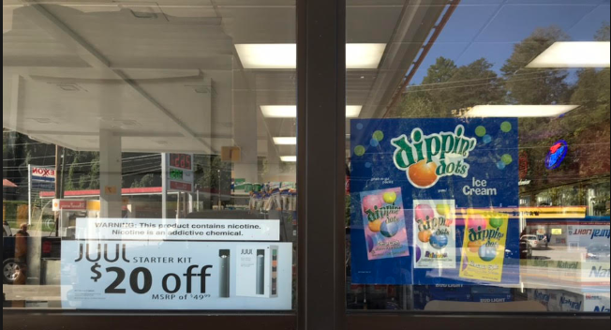
EXAMPLE AD 2
Notes:
Possible Answer(s): Freedom

Slide 20
EXAMPLE AD 3
Notes:
Possible Answer(s): Freedom, Social Life, Health

Slide 21
EXAMPLE AD 4
Notes:
Possible Answer(s): Sports, Masculinity

Slide 22
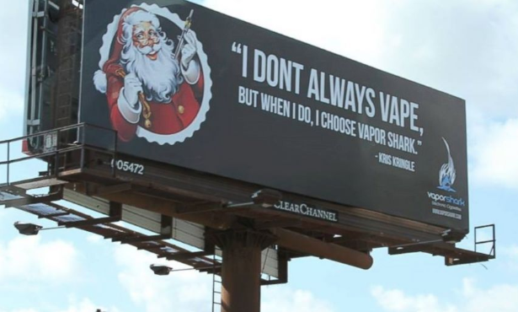
EXAMPLE AD 5
Notes:
Possible Answer(s): Freedom

Slide 23
ACTIVITY 2: WARNING LABELS
Notes:
Activity 2: Warning Labels (12 min.)
Distribute one copy of the Session 3, Activity 2: Warning Labels worksheet to each group
Introduce Warning Label Project: Peer Group Facilitators will use Peer Group Facilitator Sheet 3: Warning Label to lead their small groups in brainstorming a creative slogan and imaging for an e-cigarette warning label.
Example: No strings attached? Think again.
Explain that the Warning Label Project will be presented to the class in the next session.
CASEL Competencies Covered
Self-awareness - identifying emotions, accurate self-perception
Self-management - organizational skills
Social awareness - perspective taking, respect for others, empathy, appreciating diversity
Relationship skills - communication, social engagement, teamwork
Responsible decision-making - identifying problems, analyzing situations, reflecting

Slide 24
ACTIVITY 2: WARNING LABELS
Each group will develop a warning label that will be presented next class period
Take time to brainstorm and plan ideas on your worksheet
Use the following questions to guide your discussion:
What your warning label will look like?
What your slogan will be?
What information you will include?
What images and/or messages will be used?
Notes:
Activity 2: Warning Label Project (12 min.)
Explain that each group will develop their own warning label for an e-cigarette (or e-liquid).
Ask students to spend the next few minutes brainstorming ideas for their warning label
Explain that the Warning Label Project will be presented to the class in the next session.
CASEL Competencies Covered
Self-awareness - identifying emotions, accurate self-perception
Self-management - organizational skills
Social awareness - perspective taking, respect for others, empathy, appreciating diversity
Relationship skills - communication, social engagement, teamwork
Responsible decision-making - identifying problems, analyzing situations, reflecting

Slide 25
REMEMBER...
Advertisements are all about taking money out of your pocket - Not to being truthful
Be aware of the advertising tricks — know the facts!
Notes:
Closing 1 minute: Review that the point of ads is to sell, not to be truthful.
Note: All photos (except advertisements) from Pixabay unless otherwise cited.

