Slide 1
SESSION 4
YOUR LIFE. YOUR CHOICE.
© 2019 The University of Texas Health Science Center at Houston. All rights are reserved. CATCH® is a registered trademark of The Regents of the University of California.

Slide 2
TESTED ON HUMANS
Notes:
Show Video “Tested On Humans” by Truth Initiative. Video image is also link: https://www.youtube.com/watch?v=KSfKikyzYgw&feature=youtu.be

Slide 3
WHAT HAVE YOU LEARNED?
What information about e-cigarettes stood out to you most over the course of this program?
With all this new information, do you feel more comfortable to make your own choice about e-cigarette use?
Notes:
Direct Instruction (5 min.)
Ask students which information about E-cigarettes stood out to them most over the course of the four 4 sessions. Compile a class list.
Class poll: With all this new information, do you feel more empowered to make your own choice about E-cigarette use?
CASEL Competencies Covered
Self-awareness - identifying emotions, accurate self-perception, self-confidence, self-efficacy
Social awareness - perspective-taking, empathy, appreciating diversity, respect for others
Relationship skills - communication, social engagement, relationship-building, teamwork
Responsible decision-making - identifying problems , analyzing situations, solving problems, evaluating, reflecting, ethical responsibility

Slide 4
SMALL GROUPS, ASSEMBLE!
Notes:
Ask the students to assemble into their peer-facilitated groups.

Slide 5
REVIEW OF SESSION 3: WARNING LABELS
Notes:
Work Time (20 min.)
Continue work on Warning Label Project: Peer Group Facilitators will use Session 3, Activity 2: Warning Labels to lead their small groups in brainstorming and finalizing their Warning Label.
Distribute blank sheets of paper or poster board and markers to your students to create their warning label.
CASEL Competencies Covered
Self-awareness - identifying emotions, accurate self-perception
Self-management - organizational skills
Social awareness - perspective taking, respect for others, empathy, appreciating diversity
Relationship skills - communication, social engagement, teamwork
Responsible decision-making - identifying problems, analyzing situations, reflecting

Slide 6
PRESENTATION IS EVERYTHING
Notes:
Presentations: Have each group present their Warning Label.
Vote (optional): Class will conduct vote to determine winning label.
CASEL Competencies Covered
Self-awareness - identifying emotions, accurate self-perception
Self-management - organizational skills
Social awareness - perspective taking, respect for others, empathy, appreciating diversity
Relationship skills - communication, social engagement, teamwork
Responsible decision-making - identifying problems, analyzing situations, reflecting

Slide 7
YOU ARE A ROLE MODEL
Notes:
Ask students:
How would you feel about your younger cousins or siblings getting hold of or smoking an e-cigarette?
What would younger kids do if they see you smoke an e-cigarette or JUUL?
CASEL Competencies
Self-awareness - accurate self-perception, self-confidence
Social awareness - perspective-taking, respect for others
Relationship skills - communication, social engagement, relationship-building
Responsible decision-making - evaluating, reflecting, ethical responsibility

Slide 8
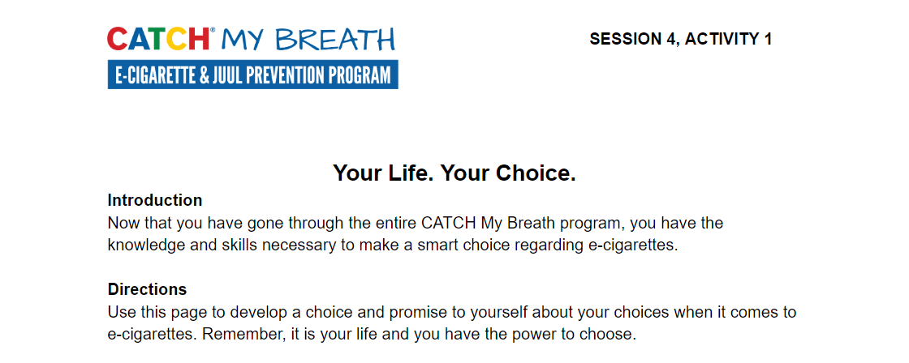
ACTIVITY 1: YOUR LIFE. YOUR CHOICE.
Notes:
Closing (5 min.)
Remind students that they are in control of their own choices and goals.
Distribute one copy of Activity 1: Your Life Your Choice worksheet to each student
CASEL Competencies
Self awareness - accurate self-perception, recognizing strengths, self-confidence, self-efficacy
Self-management - impulse control, stress management, self-discipline, self-motivation, goal-setting, organizational skills
Social awareness - perspective-taking, empathy, appreciating diversity, respect for others
Relationship skills - communication, social engagement, relationship-building, teamwork
Responsible decision-making - identifying problems, analyzing situations, solving problems, evaluating, reflecting, ethical responsibility

Slide 9
ACTIVITY 1: YOUR LIFE. YOUR CHOICE.
Take the next few minutes to carefully think about your choice regarding e-cigarettes.
Remember, this is YOUR choice (and only yours).
Notes:
Closing (5 min.)
Ask students to take the next few minutes to think critically and respond to the questions listed on their worksheet. It is okay if they need more time to finish the activity after class
Remind students that this choice is about their lives, not their classmates or friends or parents. They need to make this decision for themselves
Ask for students to volunteer to share their choice (if there is time in class)
CASEL Competencies
Self awareness - Self efficacy, self confidence
Self-management- self motivation

Slide 10
CONGRATULATIONS!
Notes:
Congratulate students on completing the CATCH My Breath Youth E-cigarette Prevention Program.
Explain: You have completed the CATCH My Breath Youth E-cigarette Prevention Program.
You now have all the information you need to make informed choices about E-cigarette usage.

