Slide 1
SESSION 1
CONSEQUENCES OF E-CIGARETTE USE
© 2019 The University of Texas Health Science Center at Houston. All rights are reserved.
CATCH® is a registered trademark of The Regents of the University of California.
Notes:
Suggested length: 35 minutes

Slide 2
WHAT IS CATCH MY BREATH?
Four 35-minute sessions that will give you crucial information about E-cigarettes so that you can make your own informed choices.
  Peer Group Facilitators will lead you in
  activities where you will:
    Identify the health hazards of E-cigarettes.
    Discuss why people begin using E-cigarettes.
    Determine positive alternatives to using E-cigarettes.
    Recognize the advertising methods the industry
    uses to make you want to try E-cigarettes.
    Practice ways to resist pressure to use E-cigarettes.
    Make your own slogan and warning label for E-cigarettes.
Notes:
Introduction (3-5 min.)
Explain CATCH My Breath includes four 35 min. sessions with crucial information about e-cigarettes. Peer Group Facilitators will lead you in activities where you will:
Identify the health hazards of using e-cigarettes.
Discuss why people begin using e-cigarettes.
Determine positive alternatives to using e-cigarettes.
Recognize the advertising methods e-cigarette companies use to make you want to try e-cigarettes.
Practice ways to resist pressure to use e-cigarettes.
Make your own advertising slogan addressing a common misconception about the product.

Slide 3
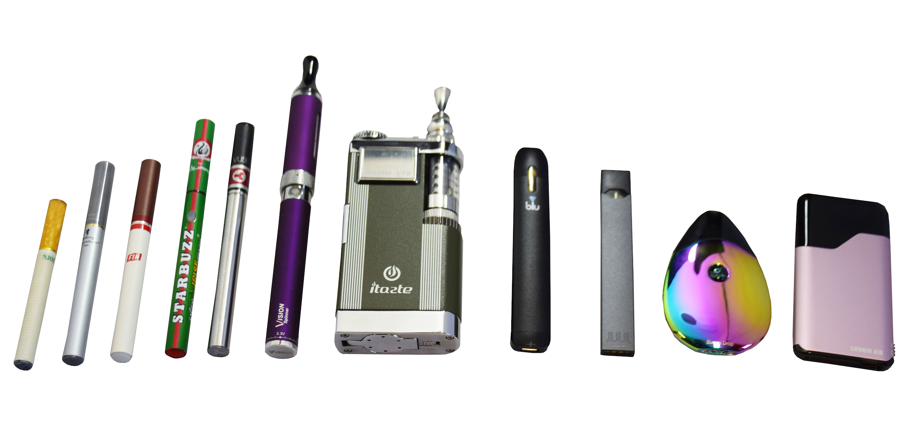
LESS HARM ≠ HARMLESS
Cigarettes and other tobacco products can cause cancer and heart disease, and eventually can kill you
Although e-cigarettes have fewer toxic chemicals than cigarettes, they are still harmful!
Notes:
Image source: https://www.health.state.mn.us/communities/tobacco/ecigarettes/index.html

Slide 4

WHAT HAVE YOU HEARD, SEEN, OR THOUGHT ABOUT E-CIGARETTES?
    Record your response to the question
    above on your index card or paper.
Notes:
Direct Instruction (10 min.)
Distribute an index card or square of paper to each student.
Ask students to record responses to the following question on their index card:
What have you heard, seen, or thought about e-cigarettes? (Stress that there are no wrong answers and they do NOT need to include their name on the index card)
Collect the index cards.
Read responses aloud to the class.
List students’ answers on the board.

Slide 5

E-CIGARETTES ARE NICOTINE DELIVERY SYSTEMS
Notes:
Show the video: https://youtu.be/tpfbBm7IofQ. The DeNoble Files: E-cigarettes? (1:18 min).

Slide 6
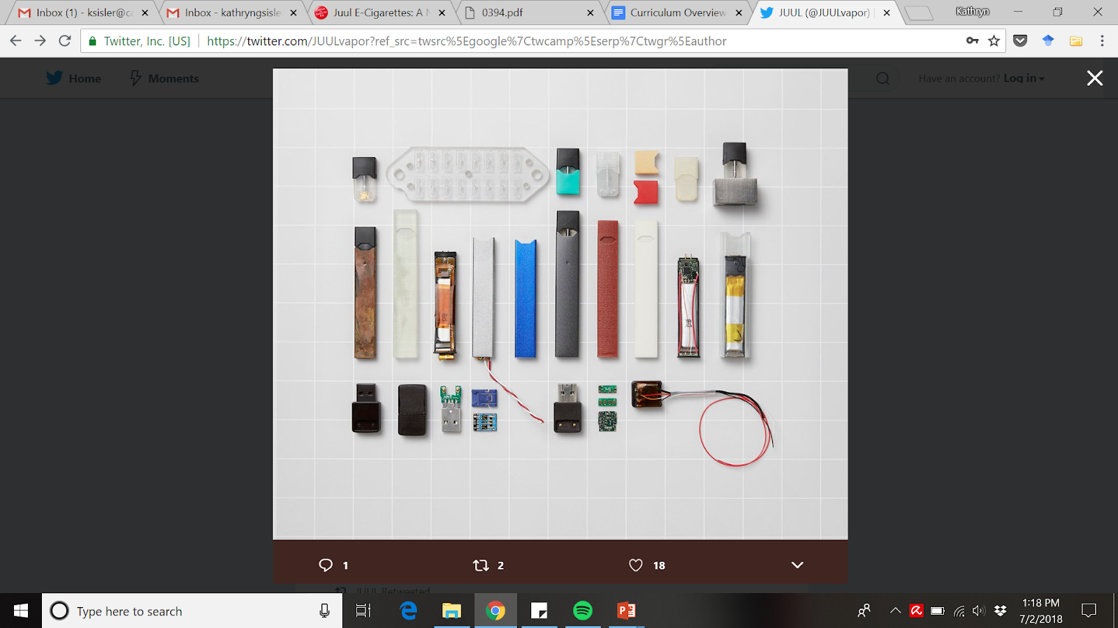
JUUL: STILL AN E-CIGARETTE
Just like other e-cigarettes, JUULing involves inhaling dangerous chemicals.
All JUUL pods contains nicotine. In fact, a single JUUL pod contains as much nicotine as a pack of cigarettes (about 200 puffs).
Notes:
Explain (2-5 mins) that there is a large amount of nicotine in each JUUL pod. JUUL is the most popular brand of e-cigarette in the US. These devices are not any different than other e-cigarettes. JUUL is often referred to as the “iPhone” of e-cigarettes because it is easy to use and has a sleek design and it is a well-known brand.
Note for Teacher: it’s important to explain to the students that you and the administration at your school know what JUULs are and will not accept the use of them in or on school property. For more information on JUUL to prepare you for this topic, visit: https://www.tobaccofreekids.org/assets/factsheets/0394.pdf
Image source: https://twitter.com/JUULvapor/status/993581260340649985

Slide 7
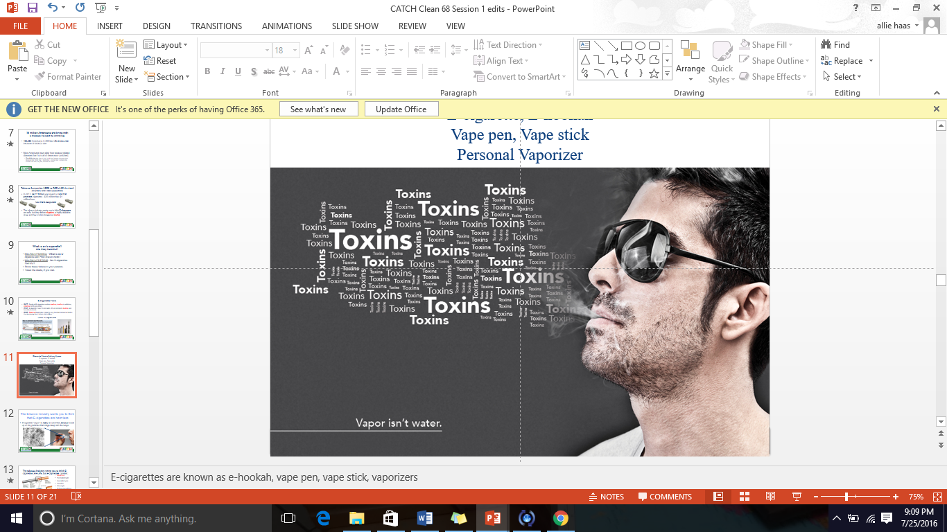
VAPOR AEROSOL
    E-cigarette “vapor” is NOT water vapor. It is made up of tiny particles containing nicotine and harmful toxic chemicals.
Notes:
Share this fact about e-cigarettes with students: e-cigarette “vapor” is NOT water vapor. It is an aerosol made up of ultrafine particles containing nicotine and harmful chemicals.
Explain to students that an aerosol is a suspension of tiny particles of liquid, solid or both within a gas as opposed to water vapor that is a substance (in this case water) in its gaseous phase.

Slide 8
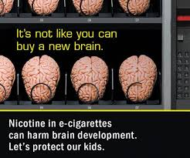
NICOTINE IS HARMFUL
    Nearly ALL e-cigarettes contain nicotine
    Nicotine causes you to be addicted to e-cigarettes making it really difficult to stop using them
Notes:
Explain: Nearly all e-cigarettes contain nicotine (including JUUL) which is a HIGHLY addictive chemical.
As a teen, your brain is still developing, making it easier for you to get addicted to nicotine.
Addiction is a brain disease. This means once you start using nicotine-based products like e-cigarettes (or any kind of tobacco) your brain gets rewired and restructured. This makes it hard to quit using any product that contains nicotine.

Slide 9
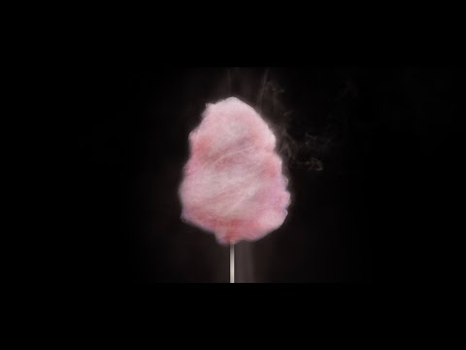
SWEET CLOUDS
Notes:
Watch: “Sweet Clouds” from the Truth Initiative.(30 seconds)
Link: https://youtu.be/ZLZMntxyBCY
Ask: Students why they think e-cigarettes come in sweet flavors like cotton candy, hawaiian punch, etc.

Slide 10
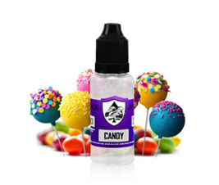
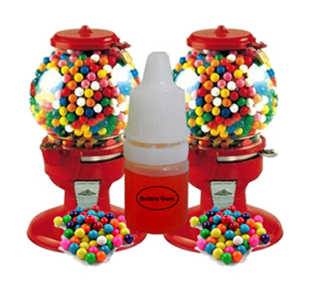
E-CIGARETTE FLAVORS
Hawaiian Punch
Gummy bears
S’mores
Skittles
Cotton candy
Sweet Tarts
Fruit Loops
Banana Split
Cool Cucumber
Who are advertisers trying to appeal to with these candy flavors?
Notes:
Explain there are more than 8,000 e-cigarette flavors on the market and 99% of them contain nicotine. E-cigarette companies claim to use flavors to help adults quit, but they are the reason most kids get hooked on nicotine and tobacco products

Slide 11
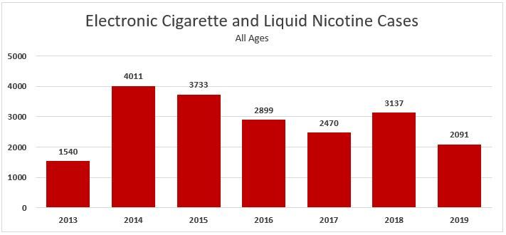
THE E-CIGARETTE FACTS
Notes:
Share the facts:
Most sweet, candy, and fruit-flavored E-cigarettes contain nicotine.
As of September 30th 2019, poison control centers 2019 have managed 3,583 exposure cases related to e-cigarettes and e-liquid
Nicotine liquid (AKA e-juice) is very harmful and possibly fatal when ingested.
Sources:
E-Cigarettes and Liquid Nicotine. (2019, June 30). Retrieved July 18, 2019, from https://aapcc.org/track/ecigarettes-liquid-nicotine
Kamboj, A., Spiller, H. A., Casavant, M. J., Chounthirath, T., & Smith, G. A. (2016). Pediatric exposure to e-cigarettes, nicotine, and tobacco products in the United States. Pediatrics, 137(6), e20160041.
Nayir, E., Karacabey, B., Kirca, O., & Ozdogan, M. (2016). Electronic cigarette (e-cigarette). Journal of Oncological Science, 2(1), 16-20.
Chatham-Stephens, K., Law, R., Taylor, E., Kieszak, S., Melstrom, P., Bunnell, R., ... & Foster, H. (2016). Exposure Calls to US Poison Centers Involving Electronic Cigarettes and Conventional Cigarettes—September 2010–December 2014. Journal of medical toxicology, 12(4), 350-357..
Chen, B. C., Bright, S. B., Trivedi, A. R., & Valento, M. (2015). Death following intentional ingestion of e-liquid. Clinical toxicology, 53(9), 914-916.

Slide 12

KNOW THE RULES AND LAWS
    All states have restrictions around the sale, purchase, or use of e-cigarettes or nicotine containers to a minor
    Visit the Public Health Law Center’s website to find out the specific laws in your state.
Notes:
Explain: All states have restrictions around the sale, purchase, or use of E-cigarettes or nicotine containers to a minor. Visit the website to find the specific restrictions and age requirements for your state. Most states require you to be at least 18, though more states are now increasing the age to 21 in order to purchase.
Share your school/district policy regarding e-cigarettes and other tobacco products.
Link: http://www.publichealthlawcenter.org/resources/us-e-cigarette-regulations-50-state-review
*Click link, click your state on the map, and scroll to “What restrictions are in place for retail or youth access?” for age restrictions and other information.*

Slide 13

DRUM ROLL PLEASE…
Announce Peer Group Facilitators
and group assignments.
Assemble into your numbered groups.
Notes:
Announce Peer Group Facilitators and group assignments.
Ask students to assemble into their groups.
CASEL Competencies Covered
Social awareness - perspective taking, respect for others
Relationship skills - communication, social engagement, relationship building, teamwork

Slide 14
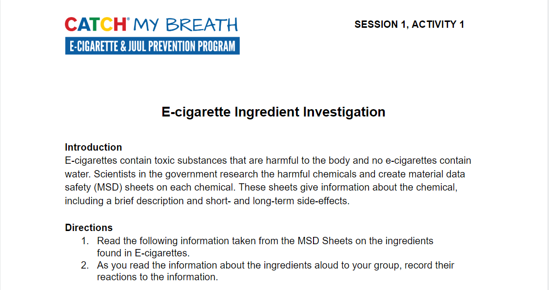
ACTIVITY 1: E-CIGARETTE
INGREDIENT INVESTIGATION
Notes:
Activity 1: E-cigarette Ingredient Investigation (10-15 min.)
Ask Peer Group Facilitators to turn to Session 1, Activity 1: E-cigarette Ingredient Investigation
CASEL Competencies Covered
Social awareness - perspective taking, respect for others
Relationship skills - communication, social engagement, relationship building, teamwork

Slide 15
ACTIVITY 1: E-CIGARETTE
INGREDIENT INVESTIGATION
Each group will read through your assigned chemical listed on the worksheet
In your groups:
  Read the description of each chemical taken from the material data safety sheet to group
  As you read the information about the ingredients aloud to your group, record their reactions to the information.
Each group should complete the “Other Substances” section
Notes:
Activity 1: E-cigarette Ingredient Investigation (10-15 min.)
Ask Peer Group Facilitators to record their group’s reactions to their assigned chemical on the sheet.
Note: It is okay if more than one group has the same ingredient.
Explain that although e-cigarettes create a vapor/aerosol, they do NOT contain any water. The e-liquid is made of lots of different chemicals and today we will explore those. The government issues something called a Material Data Safety (MSD) sheet which give information about the chemical and it’s harmful side-effects.
CASEL Competencies Covered
Social awareness - perspective taking, respect for others
Relationship skills - communication, social engagement, relationship building, teamwork

Slide 16
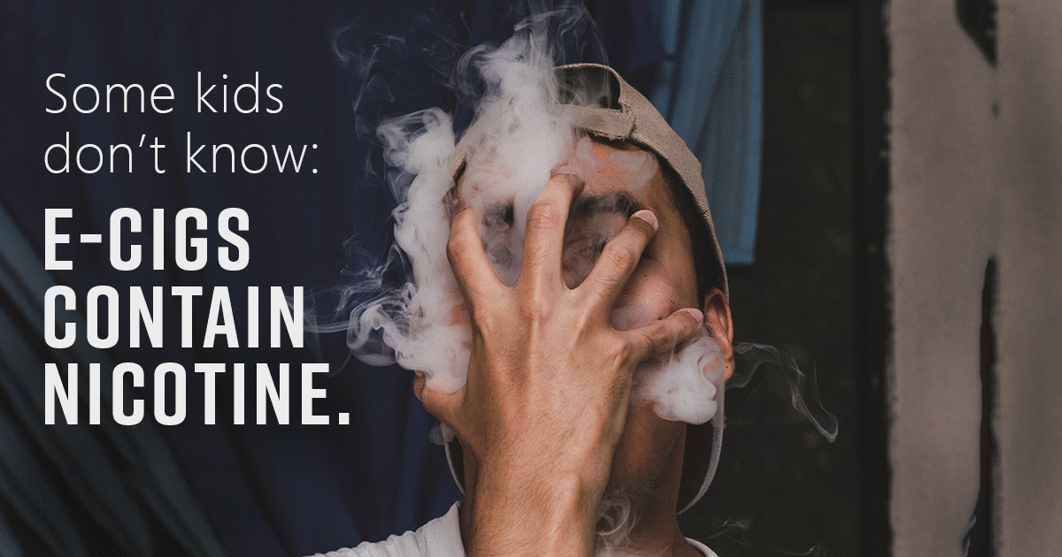
ACTIVITY 1: E-CIGARETTE
INGREDIENT INVESTIGATION
Please summarize what you found out about:
  Nicotine
  Formaldehyde
  Propylene glycol
  8,000+ flavor chemicals
Notes:
Ask students:
How do you feel about the e-cigarette ingredients?
Do you think people who use e-cigarettes know the details about these ingredients?
CASEL Competencies Covered
Social awareness - perspective taking, respect for others
Relationship skills - communication, social engagement, relationship building, teamwork

Slide 17
ACTIVITY 2: NEGATIVE CONSEQUENCES OF USING E-CIGARETTES
On your index card or paper:
  List negative consequences of using e-cigarettes
  Include, but think beyond health consequences
  Think about how e-cigarettes could affect social relationships, family relationships, personal identity, and goals
  After 3 minutes, Peer Group Facilitators will collect the index cards and read them aloud to the group
Notes:
Activity 2: Negative Consequence of Using E-cigarettes (5-7 minutes)
Distribute an index card or square of paper to each student.
Ask each student to write down what they think are negative consequences (or side-effects) of using e-cigarettes
Explain these can be related to your health, but they should also think about their family, friends, and pocketbook.
CASEL Competencies Covered
Responsible decision-making - identifying problems, analyzing situations, evaluating, reflecting, ethical responsibility
Self-awareness - identifying emotions, accurate self-perception, self-confidence
Relationship skills - communication, social engagement

Slide 18
ACTIVITY 2: NEGATIVE CONSEQUENCES OF USING E-CIGARETTES
Possible Answers
  Costs a lot of money, about $50 to get started
  Long-term addiction
  Aerosol contains toxic chemicals
  Poor influence on younger siblings
  Get in trouble at school or at home (parents)
  Get suspended from school activities (sports)
  Get in trouble with the law
  Harms babies
  Harms your body (organ damage)
  Nausea, dry mouth, dizziness, coughing/wheezing, worsens/trigger asthma
  Ingesting e-liquid can be FATAL
Notes:
Activity 2: Negative Consequence of Using E-cigarettes (5-7 minutes)
Review the answers students gave. Write them on a whiteboard or space where all students can see the collection of responses.
CASEL Competencies Covered
Responsible decision-making - identifying problems, analyzing situations, evaluating, reflecting, ethical responsibility
Self-awareness - identifying emotions, accurate self-perception, self-confidence
Relationship skills - communication, social engagement
Citation:
National Academies of Sciences, Engineering, and Medicine. (2018). Public health consequences of e-cigarettes. National Academies Press.

Slide 19
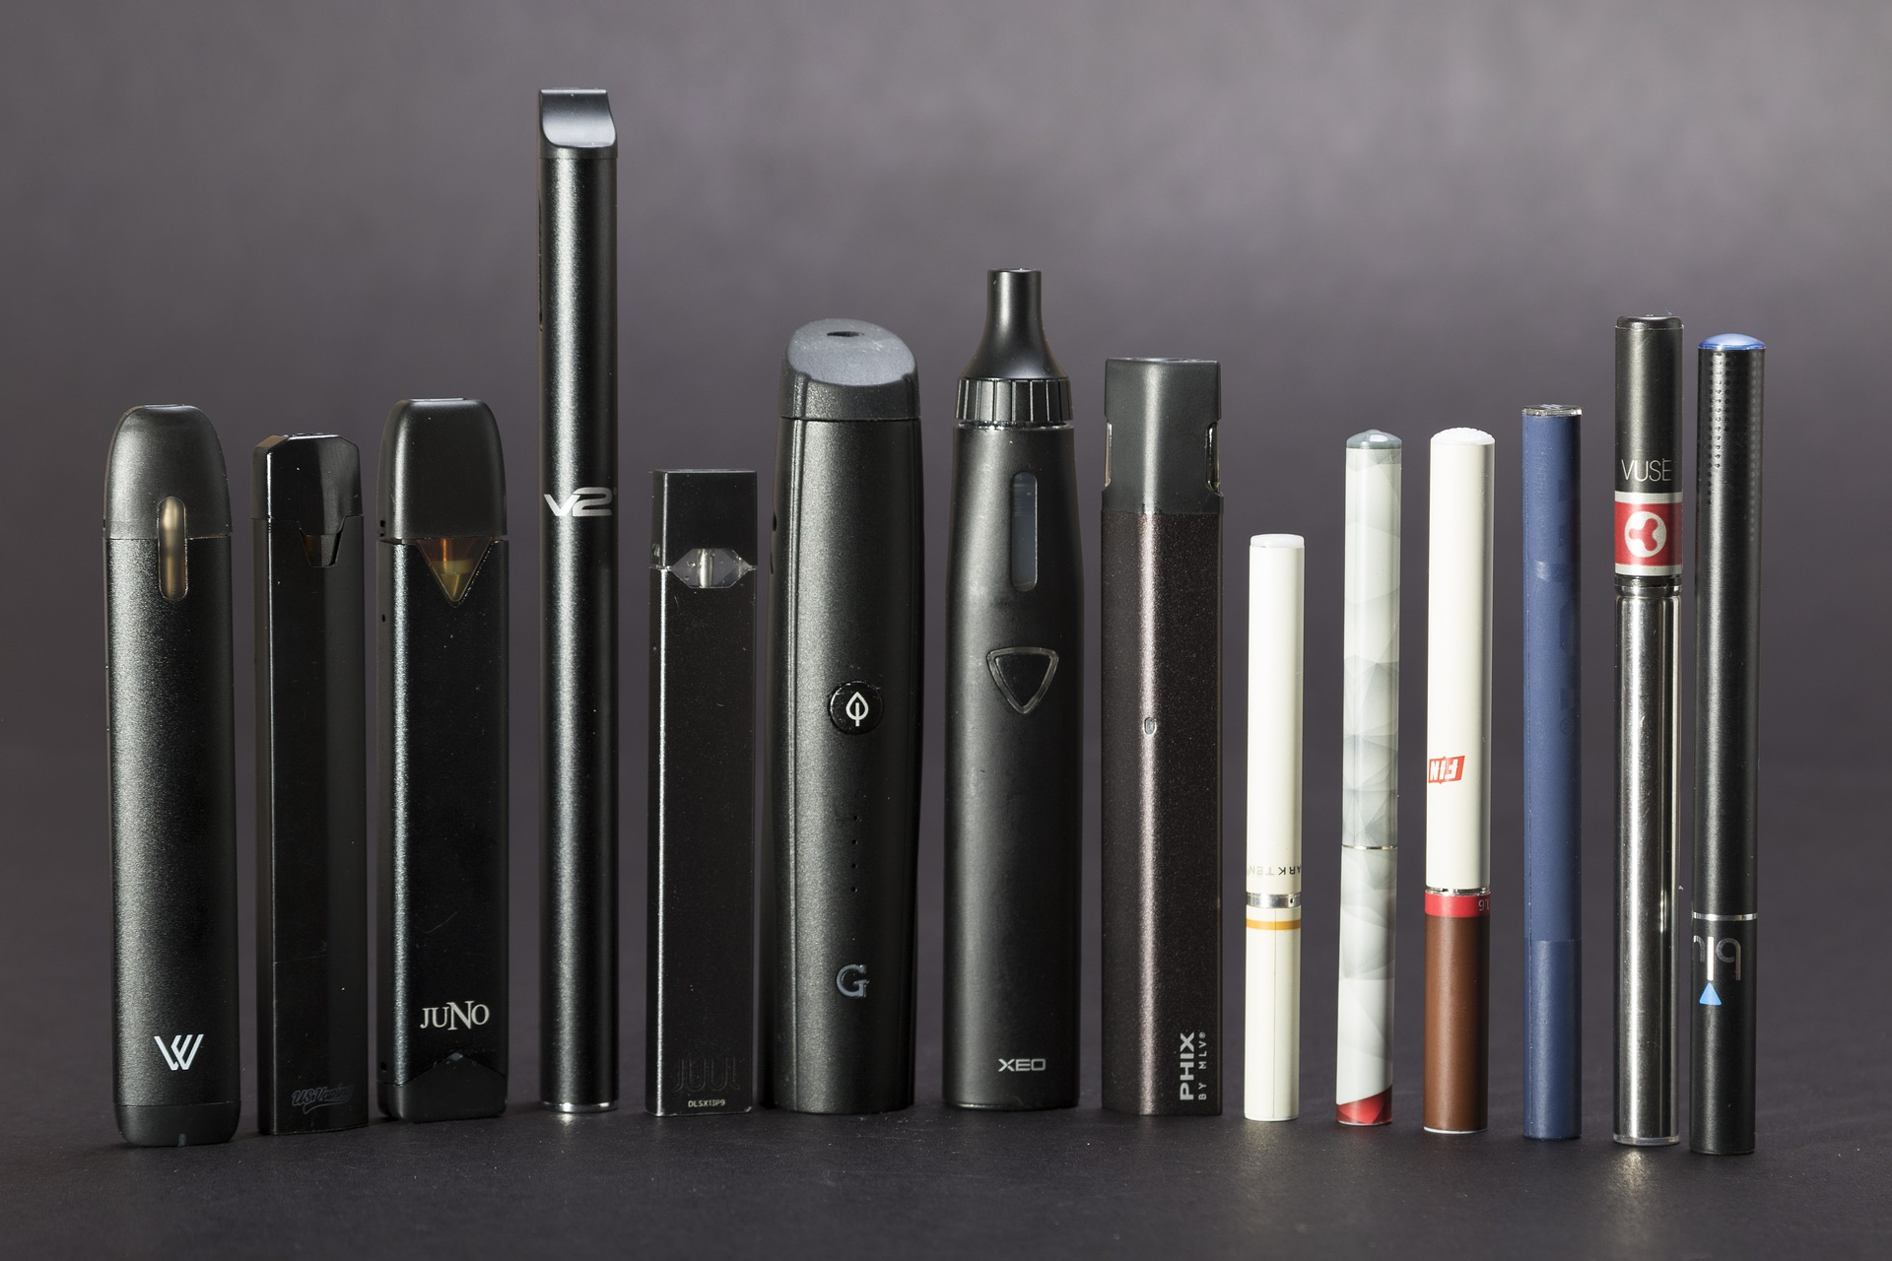
WHAT NEW INFORMATION HAVE YOU GAINED?
Notes:
Closing (3-5 min.)
Review the list of what students had heard, seen or thought about E-cigarettes.
Ask: What new Information have you gained?
All photos unless otherwise cited were sourced from Pixabay.

