Slide 1
SESSION 2
MAKING OUR OWN CHOICES
© 2019 The University of Texas Health Science Center at Houston. All rights are reserved. CATCH® is a registered trademark of The Regents of the University of California.

Slide 2
THE REAL COST: NICOTINE
Notes:
Watch “Nicotine = Brain Poison” (30 sec) and discuss impression with class.
Link: https://www.youtube.com/watch?v=-BqQaJaeMII

Slide 3
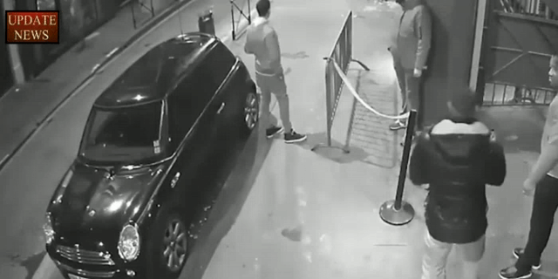
E-CIGARETTES ARE KNOWN TO OCCASIONALLY EXPLODE IN YOUR POCKET OR YOUR MOUTH…
Figure 1. Initial presentation. A, extraoral view of lips. B, Upper labial mucosa. C, Lower labial mucosa. D, Teeth involved. E, Hard palate. F, Soft palate.
Roger et al. Oral Trauma After Explosion of E-Cigarette. J Oral Maxillofac Surg 2016
Notes:
Explain: Some types of e-cigarettes are known to occasionally explode in your pocket or your mouth.
While there have been no reports of JUUL and other USB e-cigarette devices exploding, several other battery-operated e-cigarette devices have the potential to explode, and have on multiple occasions. There have been multiple reports of battery-operated e-cigarettes exploding either due to user or manufacturer error.

Slide 4
TAKE A GUESS
What percentage of middle school students have smoked e-cigarettes in the past 30 days?
What percentage of high school students have smoked e-cigarettes in the past 30 days?
Notes:
Direct Instruction (5 min.)
A. Ask students to guess the following on scratch paper:
What percentage of middle school students have smoked e-cigarettes in the past 30 days?
What percentage of high school students have smoked e-cigarettes in the past 30 days?
B. Ask students to share their guesses.
CASEL Competency
Self-awareness - accurate self-perception
Social awareness - perspective-taking

Slide 5
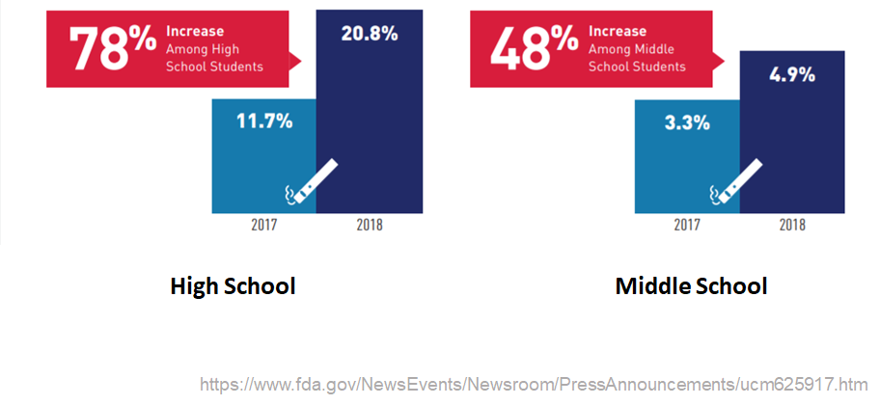
THE TRUTH
Notes:
Reveal: the actual numbers: 4.9% of middle schoolers and 20.8% of high-schoolers and have smoked an e-cigarette in the last 30 days.
Discuss: Most teenagers surveyed disapproved of e-cigarette use. Very few high schoolers, and even fewer middle school students, smoke e-cigarettes.
Ask:
Are these numbers surprising?
Why do you think students’ estimates are usually higher than the actual number? (possible answers: advertising, YouTube and social media, bragging, etc.)
*Note: Students often overestimate the number or people they think use e-cigarettes, just as they do with conventional cigarettes. By presenting facts about the teen prevalence of E-cigarette usage, students will understand that not “everybody does it.”
CASEL Competency
Self-awareness - accurate self-perception
Social awareness - perspective-taking
Source
Wang, T. W., Gentzke, A., Sharapova, S., Cullen, K. A., Ambrose, B. K., & Jamal, A. (2018). Tobacco Product Use Among Middle and High School Students — United States, 2011–2017. MMWR. Morbidity and Mortality Weekly Report, 67(22), 629-633. doi:10.15585/mmwr.mm6722a3

Slide 6
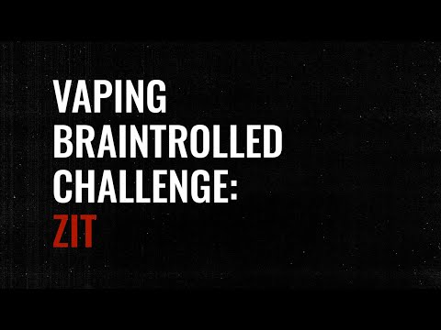
WHAT HAPPENS WHEN YOU VAPE?
Notes:
Direct Instruction (5 min.)
Show: The Real Cost “Good Luck Getting That Out” (15 sec) https://www.youtube.com/watch?v=xQy9xKeow2k
Small Group Discussion: Within their groups, ask students to discuss:
What does the word “addiction” mean to you?
How do you feel about the possibility of becoming addicted to something?
Define addiction as loss of control that causes you to need a substance in order to feel okay. The more you use it, the more you will need to feel good.
Explain E-cigarettes are designed to get you addicted to nicotine even with just a few uses.
Share It can take 6-19 attempts to quit nicotine even with help from your doctor.

Slide 7
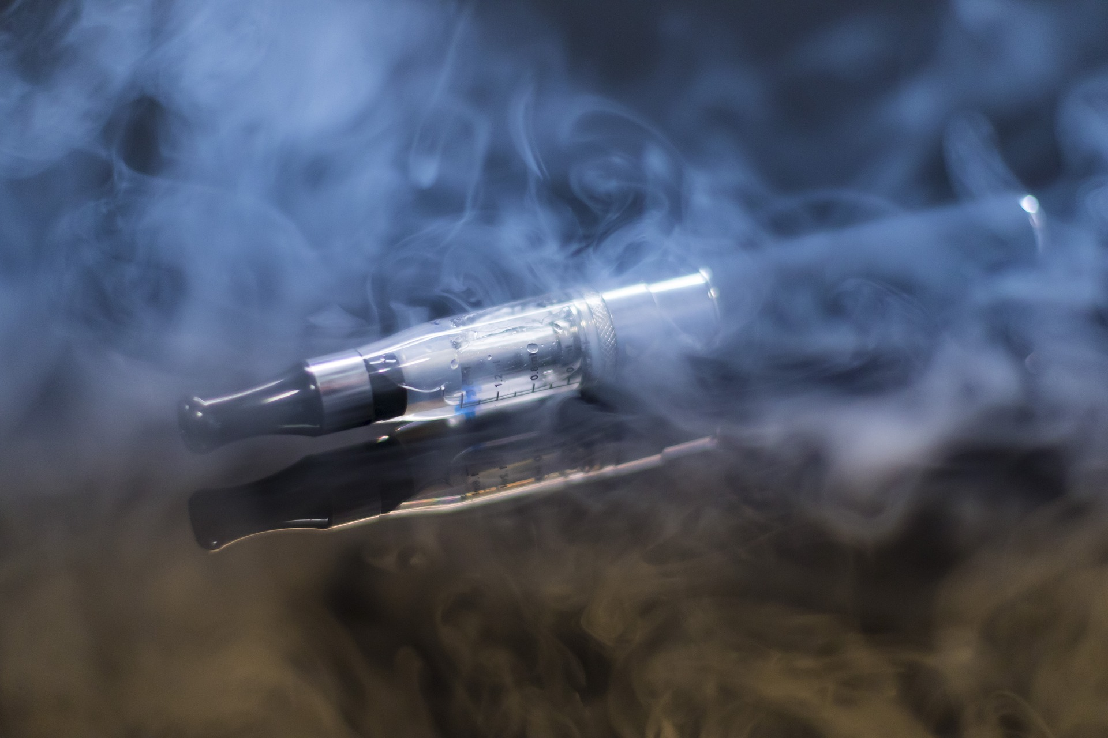
WHAT IS MORE ADDICTIVE…
NICOTINE
CAFFEINE
Notes:
Class Poll: have students raise their hands if they think the second substance is more addictive.
Ask: What do you think is more addictive — nicotine or caffeine?

Slide 8
WHAT IS MORE ADDICTIVE…
NICOTINE
ALCOHOL
Notes:
Class Poll: have students raise their hands if they think the second substance is more addictive.
Ask: What do you think is more addictive — nicotine or alcohol?

Slide 9
WHAT IS MORE ADDICTIVE…
NICOTINE
MORPHINE
Notes:
Class Poll: have students raise their hands if they think the second substance is more addictive.
Ask: What do you think is more addictive — nicotine or morphine?

Slide 10
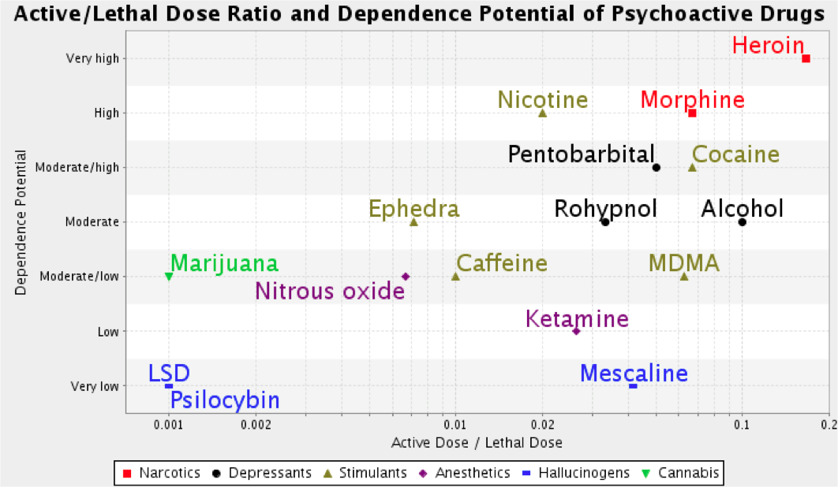
NICOTINE ADDICTION LEVEL
Heroin is the only thing more addictive than Nicotine!
Notes:
Reveal the actual addictive potential of nicotine is much higher than caffeine, alcohol, and cocaine.
Explain: This graph shows a list of various addictive substances (nicotine included) and their different degrees of addiction. The vertical axis (y-axis) shows the dependence level, while the horizontal (x-axis) shows the amount of the substance that can cause harm to the body. A relatively small amount of nicotine (0.02) is enough to not only cause harm to the body but get you addicted as well, leading to long term irreversible damage to the body!
Also you can see from the graph, nicotine HAS A HIGH LEVEL OF ADDICTION! THe only substance more addictive than nicotine is HEROIN!

Slide 11
SMALL GROUPS, ASSEMBLE!
Notes:
Work Time 20-25 minutes
Ask the students to assemble into their peer-facilitated groups.
CASEL Competencies Covered
Social Awareness - perspective taking, appreciating diversity, respect for others
Self-management - impulse control, stress management, self-discipline
Relationship skills - communication, social engagement, relationship-building

Slide 12
ACTIVITY 1: WHY DO IT?
On the front of your index card, record responses to the following question:
Why might kids your age experiment with e-cigarettes?
On the back of your index card, record responses to the following question:
What are some positive things kids your age can do instead of using e-cigarettes?
Notes:
Activity 1: Reasons Why Young People Experiment with E-cigarettes and Positive Alternatives (10 min.)
Distribute an index card or cut up paper square to each student.
Ask students to independently record responses to the following question on the front side of their index card: Why might young people experiment with E-cigarettes? On the back side, record responses to the following question: What are some positive things young people can do instead of using E-cigarettes?
Ask Peer Group Facilitators to collect the index cards and read the reasons for use and positive alternatives aloud to their group
Ask Peer group facilitators to share 2-3 of the reasons for use and positive alternatives with the whole class.
CASEL Competencies Covered
Social Awareness - perspective taking, appreciating diversity, respect for others
Self-management - impulse control, stress management, self-discipline
Relationship skills - communication, social engagement, relationship-building

Slide 13
ACTIVITY 1: WHY DO IT?
Reasons to Try E-Cigarettes | Potential Positive Alternatives
If friends use e-cigarette | Be yourself. Help your friends learn about the harm of e-cigarette use. Figure out your passion and join a sports team or a club; invite friends to a movie; tell a joke.
If family members (parents/siblings) use e-cigarettes | Inform family members about the dangers of e-cigarette use. Try to institute changes at home requesting family members not smoking around you. Be the voice of reason.
The flavors look and smell tasty (varied flavouring especially mint, candy, fruit or chocolate. | Make your own smoothie with a variety of fruits and vegetables. Get a fresh-pressed juice. Eat or drink something with flavour you like. Indulge in healthier options with intriguing flavours.
Just Curious | Ask lots of questions and research the facts.
Less harmful than other forms of tobacco such as cigarettes | Help friends understand that although e-cigarettes are less harmful, they contain harmful toxins and cause addiction, a brain disease.
Notes:
Read: Example reasons for use and positive alternatives to the class
Data source: 2018 Morbidity and Mortality Weekly Review (Tsai, J., Walton, K., Coleman, B. N., Sharapova, S. R., Johnson, S. E., Kennedy, S. M., & Caraballo, R. S. (2018). Reasons for electronic cigarette use among middle and high school students—National Youth Tobacco Survey, United States, 2016. Morbidity and Mortality Weekly Report, 67(6), 196.)
Although e-cigarettes have the potential to benefit adult smokers if used as a complete substitute for combustible tobacco smoking , the use of any form of tobacco by adolescents is considered unsafe.
CASEL Competencies Covered
Social Awareness - perspective taking, appreciating diversity, respect for others
Self-management - impulse control, stress management, self-discipline
Relationship skills - communication, social engagement, relationship-building

Slide 14
ACTIVITY 2: JUST SAY ‘NO’
What are some ways someone could refuse an offer to try an E-cigarette?
Notes:
Activity 2: Refusal Skills (15 min.)
Ask: What are some situations and places in which you may be offered an e-cigarette? For example, in the school bathroom, locker room, in class, at at party.
Record situations and places on the board or scratch paper.
Explain: With your group, you will brainstorm smart exit strategies/refusals to use when offered an e-cigarette. Record the strategies on scratch paper.
CASEL Competencies Covered
Self-management - impulse control, self-discipline
Self-awareness - identifying emotions, self-confidence, self-efficacy
Social awareness - perspective-taking, respect for others
Relationship skills - communication, social engagement
Responsible decision-making - analyzing situations, evaluating, reflecting

Slide 15
ACTIVITY 2: JUST SAY ‘NO’
Some examples of an exit strategy or refusal when you are offered an e-cigarette:
Simply say "No thanks, I'm good."
Hang out with non-smoking friends
Suggest something else to do
Give your reason for not wanting to use an e-cigarette
Add some humor
Notes:
Review: example exit strategies
CASEL Competencies Covered
Self-management - impulse control, self-discipline
Self-awareness - identifying emotions, self-confidence, self-efficacy
Social awareness - perspective-taking, respect for others
Relationship skills - communication, social engagement
Responsible decision-making - analyzing situations, evaluating, reflecting

Slide 16
ACTIVITY 2: JUST SAY ‘NO’
Form a circle.
Toss the ball to each other.
When you receive the ball, give a unique exit line or refusal to remain standing
Notes:
Game: Instruct students to form a circle.
Explain: We are going to see who has the best refusal skills. You will toss the ball to each other. When you receive the ball, you must give one refusal/exit strategy. You must come up with a unique refusal on the spot to remain standing. Can play until the last student standing wins, or as time permits.
CASEL Competencies Covered
Self-management - impulse control, self-discipline
Self-awareness - identifying emotions, self-confidence, self-efficacy
Social awareness - perspective-taking, respect for others
Relationship skills - communication, social engagement
Responsible decision-making - analyzing situations, evaluating, reflecting

Slide 17
KNOWLEDGE IS POWER
Approximately 2 in 5 kids your age don’t think regular use of e-cigarettes is harmful.
Over 50% of kids your age don’t think there is nicotine in flavored e-cigarettes.
Sharing information is a better strategy than being mean or putting someone down because of their e-cigarette use.
Notes:
Explain: Most people who use e-cigarettes don’t have the information you have. Almost half of current users didn’t believe there were any health risks at all. Sharing information is a better strategy than being mean or harsh about someone’s e-cigarette use.
CASEL Competency Covered
Self-awareness - accurate self-perception
Social awareness - perspective taking
Relationship skills - communication
Information Source: Wang, T. W., Trivers, K. F., Marynak, K. L., O'Brien, E. K., Persoskie, A., Liu, S. T., & King, B. A. (2018). Harm perceptions of intermittent tobacco product use among US youth, 2016. Journal of Adolescent Health, 62(6), 750-753.

Slide 18
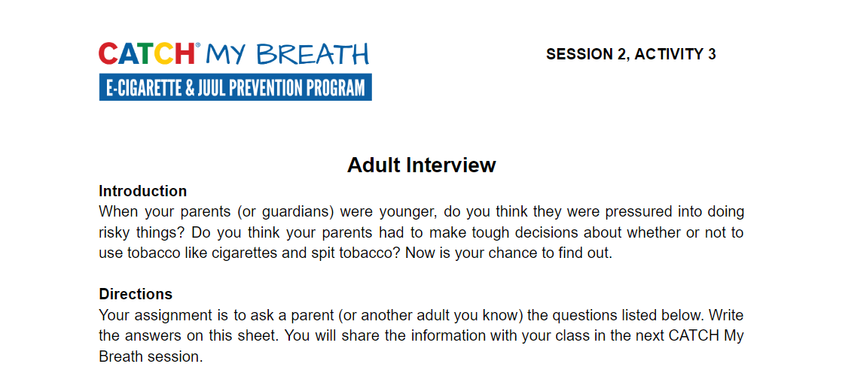
ASSIGNMENT: ADULT INTERVIEW
Notes:
Closing (1 min.)
Distribute one copy of the Session 2, Activity 3: Adult Interview worksheet to each student
Assignment Activity 3: Adult Interview.
Explain: You will quiz your parents (or another adult) on their e-cigarette knowledge. Bring the completed interview next session to discuss.
CASEL Competencies Covered
Self management - self-motivation, stress management
Social awareness - empathy, perspective-taking, respect for others
Relationship skills - communication, social engagement, relationship-building
All photos sourced from Pixabay unless otherwise cited.

