Slide 1
SESSION 3
DON’T LET THEM LIE AND WIN
© 2019 The University of Texas Health Science Center at Houston. All rights are reserved. CATCH® is a registered trademark of The Regents of the University of California.

Slide 2
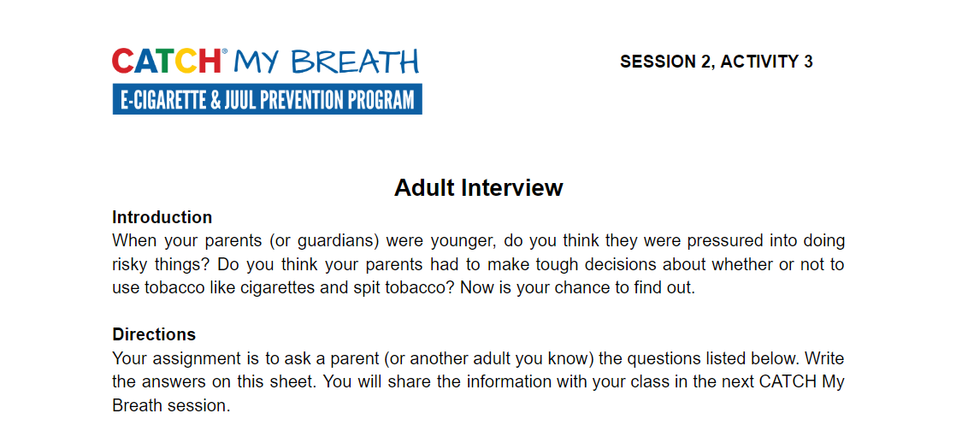
ADULT INTERVIEW DEBRIEF
Notes:
Introduction (5 min.)
Ask students to bring out Handout 2: Adult Interview. Ask the following questions:
Did your adult give any good advice for resisting peer pressure?
Did your adult know the facts about E-cigarettes?
CASEL Competencies Covered
Self management - self-motivation, stress management
Social awareness - empathy, perspective-taking, respect for others
Relationship skills - communication, social engagement, relationship-building

Slide 3
WHERE WOULD IT HAPPEN?
In what places or situations would you be most likely offered an e-cigarette?
Have you ever been around other kids who use e-cigarettes?
Notes:
Direct Instruction 5-10 minutes
Ask and discuss what places or situations your students could be offered an e-cigarette.
Give examples again here.
CASEL Competencies Covered
Relationship skills - social engagement
Responsible decision-making - analyzing situations, evaluating, reflecting

Slide 4
PEERS UNDER PRESSURE
You might feel pressure from your peers to try an e-cigarette, but…
MOST pressure comes from advertisements on TV, movies, magazines and the internet.
Notes:
Explain: Peers can directly pressure you to try e-cigarettes by offering you one, or may indirectly pressure you simply by smoking around you. Most of the pressure and curiosity to try e-cigarettes, however, has been created by advertisements.
CASEL Competencies Covered
Self-awareness - identifying emotions, accurate self-perception, self-confidence
Self-management - impulse control, self-discipline, self-motivation
Relationship skills - resisting in appropriate social pressure

Slide 5
ADS ALL AROUND YOU
Advertising is designed to pressure or convince you to buy products.
E-cigarette companies want you to try e-cigarettes and get addicted to nicotine.
They want your money, so the big companies make e-cigarettes look delicious, cool, fun and glamorous.
They don’t tell you the negative information.
Notes:
Remind students that E-cigarette companies want you to buy and become addicted to their products so they can make money.
CASEL Competencies Covered
Self-awareness - identifying emotions, accurate self-perception, self-confidence
Self-management - impulse control, self-discipline, self-motivation
Relationship skills - resisting in appropriate social pressure

Slide 6
DID YOU KNOW…
$9.5 billion is spent every year on tobacco and e-cigarette advertising
That’s more than $26 million every day, or more than $1 million every hour
About $29 for every person (adults and children) in the U.S per year!
Notes:
Share the statistic: $9.5 billion is spent every year on tobacco and e-cigarette advertising, social media and promotion—more than $26 million every day, or more than $1 million every hour.

Slide 7
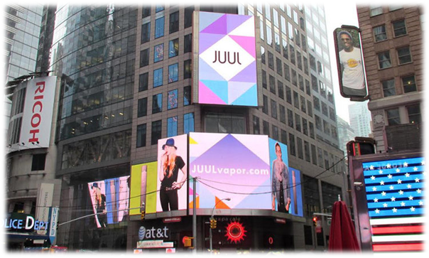
WHERE DOES THE MONEY COME FROM?
How can tobacco companies spend billions on advertising?
Notes:
Ask: How are tobacco companies able to afford to spend billions annually on advertising? (Click once to show answer)
Explain: Many of their customers are addicted to their products like e-cigarettes and regular cigarettes. The customers buy A LOT of e-cigarettes and regular cigarettes and the money is used to pay for advertising.
Review: Don’t forget that much of the social media (Instagram, Snapchat) and YouTube ads you see are paid for by the industry! In reality, only a very small percentage of teens use e-cigarettes.
Image Source: https://www.spencer-pederson.com/work-1/2017/2/23/juul-go-to-market

Slide 8
APPEALING TO ALL TYPES
Companies use a technique called an appeal which help to grab your attention and persuade you to buy or do something.
Common appeals used by the e-cigarette and tobacco industry are:
Health
Flavor
Social Life
Celebrity
Freedom
Sports
Masculinity/Femininity
Glamor/Beauty
Notes:
Explain: Companies use a technique called an appeal which help to grab your attention and persuade you to buy or do something.
Share: The e-cigarette industry uses many appeals, but the following are the most common:
Health - using the product will help you live a healthier lifestyle or be a healthier person
Flavor - the product tastes good so therefore it is safe for you to use
Social Life - using the product will help you feel more included, respected, and accepted by your friends and other people you might want to be friends with
Celebrity - using or buying this product will make you more like your favorite celebrity or movie star OR you could see a celebrity using the product and because they use it, you feel it is safe and okay for you to use as well
Freedom - the idea that using their product will allow you to be free
Sports - if you use the product, you will be better at sports, and more like your favorite professional athletes you could see a sports star using the product and because they use it, you feel it is safe and okay for you to use as well
Masculinity/Femininity - this gets at the idea that you might want to be a perfect boy or girl. They want you to think that if you use their product you will be more attractive and wanted by other people
Glamor/Beauty - these products appear to be perfect and will help you get to that stage too.

Slide 9
DIRECT ADVERTISING
Advertising that is obviously paid for by a given industry and a “call to action” is clearly stated like “Buy me now!”
Examples: billboards, TV ads, internet banner ads, radio ads, magazine ads
Notes:
Explain: E-cigarette companies use two types of advertising pressure:
Direct Pressure: advertising that everyone knows is paid for by an industry and they will ask you to do something - usually spend money on their products.

Slide 10
DIRECT ADVERTISING EXAMPLES
Notes:
Explain: These are two direct advertising examples from JUUL. On the left - an email campaign pushed out to their existing user base, on the right - a campaign from their social media (Instagram + Twitter). Both examples were developed and paid for by JUUL.

Slide 11
INDIRECT ADVERTISING
Advertising that doesn’t try and sell you something right away, but rather reminds you of a product you already know about
This helps companies build “brand recognition” so when you see their logo or something else associated with them, you will be more likely to buy their product.
Notes:
Explain Indirect Advertising includes the mediums below AND Big tobacco pressures the mass media not to print bad things about vaping and smoking
Indirect Advertising: Hides that it is an add - the company wants to remind you of their product without actually asking you to buy it. Think of seeing the Nike or Apple logos - just by seeing the mark or name, you know what they sell and their slogan and can usually get a picture of the product in your mind.
Social Media: Big tobacco companies pay people to post about tobacco and e-cigarettes to glamorize and make them look “cool”, fun, social, delicious.
Movies/Television: Tobacco and e-cigarette companies pay actors to smoke their brands in movies/television.
Magazines/Newspapers: Some magazines choose to take money from the tobacco and e-cigarette industry to promote products as part of a glamorous lifestyle

Slide 12
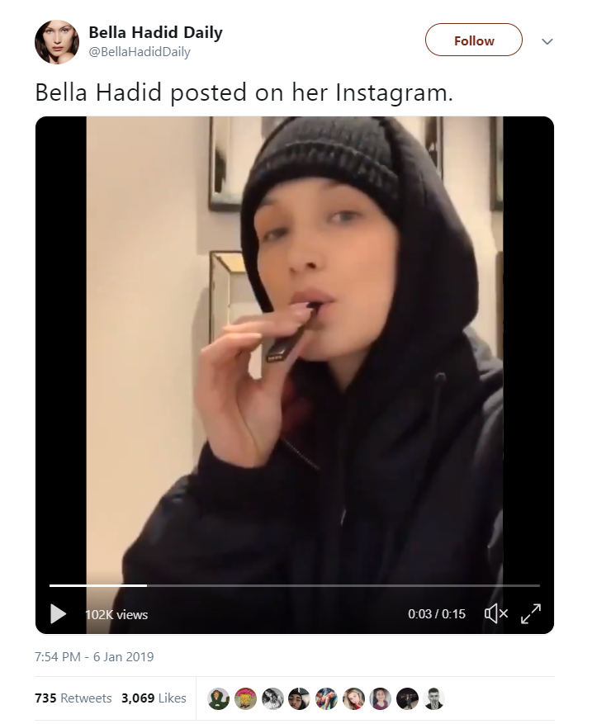
INDIRECT ADVERTISING EXAMPLE
Notes:
Social Media: Bella Hadid (famous model) posted a video on Instagram vowing to quit using JUUL - with a video of her using a JUUL.

Slide 13
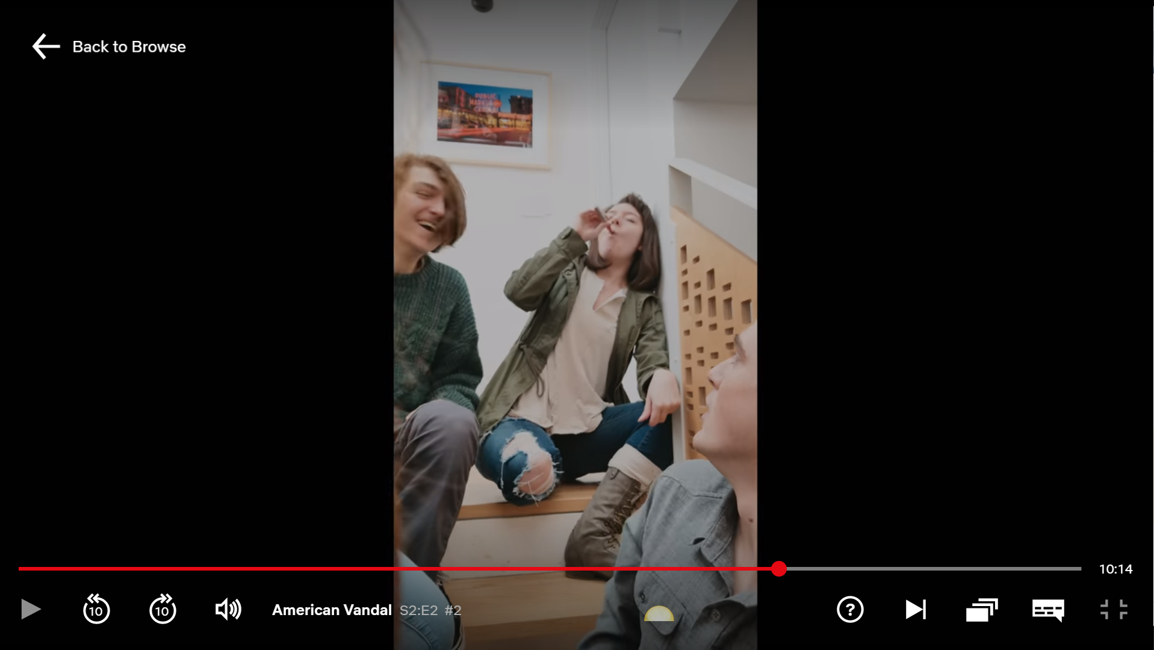
INDIRECT ADVERTISING EXAMPLE
Notes:
Television: Popular Netflix Show - American Vandal, encourages a group of six students to finish an entire JUUL pod in an hour

Slide 14
INDIRECT ADVERTISING EXAMPLE
Notes:
Ask: have you seen a TV show or movie with a character using an e-cigarette?
Explain: E-cigarette use has started to pop up in TV shows and movies, although it is a not as widespread as traditional cigarette use was.
Don’t believe the hype.. it’s a form of indirect advertisement! Often celebrities get paid to use an e-cigarette or other tobacco products in TV shows and movies - it is the same with other products like soda and clothing/accessories
The following are the examples in the image above.
Leonardo DiCaprio at the SAG Awards
Jack Black vaping in the movie Sex Tape.
Johnny Depp vaping in the movie The Tourist.
Rodrigo Santoro vaping in the movie Focus
John Cusack vaping in the movie Drive Hard.

Slide 15
INDIRECT ADVERTISING EXAMPLE
Notes:
Magazines (online): Vanity Fair running an article about actor Sophie Turner (from Game of Thrones and X-Men) and her JUUL

Slide 16
THE REAL COST: MAGIC TRICKS
Notes:
Watch: The Real Cost: Magic Tricks. Tell students to keep this in mind as we participate in the next activity.
Link: https://youtu.be/nE8fOLH1LrY

Slide 17
ASSEMBLE INTO YOUR SMALL GROUPS
Notes:
Ask the students to assemble into their numbered groups.

Slide 18
ACTIVITY 1: ANALYZING ADS
Notes:
Activity 1: E-cigarette Advertising Appeals (10-15 min.)
Ask Peer Group Facilitators to turn to Session 3, Activity 1: E-cigarette Advertising Appeals Worksheet
CASEL Competencies Covered
Self-awareness - accurate self-perception
Social awareness - perspective taking, respect for others
Responsible decision-making - identifying problems, analyzing situations, reflecting

Slide 19
ACTIVITY 1: ANALYZING ADS
Answer these questions in your group:
How does each ad portray e-cigarette use?
Which advertising appeals were used?
*Note: there can be more than one appeal used for each ad
Notes:
Activity 1: E-cigarette Advertising Appeals (10-15 min.)
Explain: I am going to display some E-cigarette ads. Jot down your reactions to the ads on some scratch paper.
Ask Peer Group Facilitators to use Peer Group Facilitator Sheet 2: E-cigarette Advertising Appeals to lead their group in discussing reactions to the ads.
CASEL Competencies Covered
Self-awareness - accurate self-perception
Social awareness - perspective taking, respect for others
Responsible decision-making - identifying problems, analyzing situations, reflecting

Slide 20
EXAMPLE AD 1
Notes:
Possible Answer(s): Flavors, Health

Slide 21
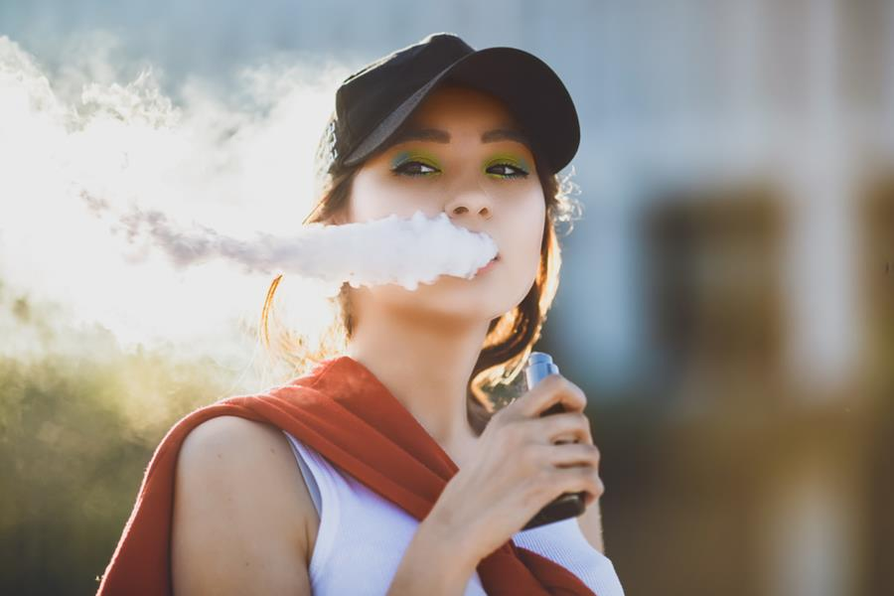
EXAMPLE AD 2
Notes:
Possible Answer(s): Social Life, Glamorous, Femininity

Slide 22
EXAMPLE AD 3
Notes:
Possible Answer(s): Freedom, Social Life, Health

Slide 23
EXAMPLE AD 4
Notes:
Possible Answer(s): Freedom, femininity

Slide 24
EXAMPLE AD 5
Notes:
Possible Answer(s): Social Life, Masculinity, Glamorous

Slide 25
WHAT DO YOU THINK?
Do these advertisements portray the reality of the toxic ingredients and potential for addiction?
Notes:
Discuss as a class: Do these advertisements portray the reality of the toxic ingredients and potential for addiction?
Photo source: https://twitter.com/blucigs/status/901617793468125184

Slide 26
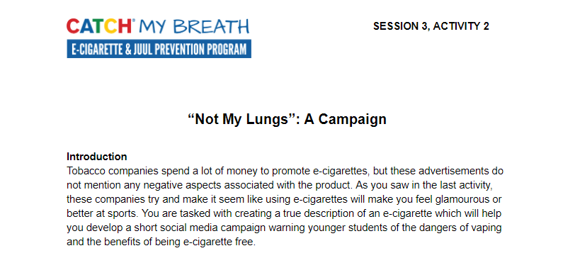
ACTIVITY 2: NOT MY LUNGS: A CAMPAIGN
Notes:
Activity 2: Not My Lungs: A Campaign (10 min.)
Review: So far in this course you have learned the truth about e-cigarette ingredients, the negative consequences of use, and advertising techniques used by the industry.
Share that although the government is working to regulate these products and how the e-cigarette and tobacco industries advertise the products, there is still a lot of false information out there being pushed by E-cigarette companies and social media influencers like: “They are as harmless as breathing air" and "The 'smoke' is harmless water vapor.”
Ask Peer Group Facilitators to turn to Session 3, Activity 2: Real Talk: A Campaign.
Explain: This activity has two parts. Part 1, which we will complete today, is creating a “true” e-cigarette description using the information you have learned in this program so far. Part 2 is creating a three-part social media campaign against e-cigarettes and using your new description. Part 2 will be started today and completed in the next lesson.
CASEL Competencies Covered
Self-awareness - identifying emotions, accurate self-perception
Self-management - organizational skills
Social awareness - perspective taking, respect for others, empathy, appreciating diversity
Relationship skills - communication, social engagement, teamwork
Responsible decision-making - identifying problems, analyzing situations, reflecting

Slide 27
ACTIVITY 2: NOT MY LUNGS - PART 1
Use these questions to help your group create a true description:
What are some things you did not know about e-cigarettes before this class?
How would you describe an e-cigarette to a younger schoolmate?
Notes:
Activity 2: Not My Lungs: A Campaign - Part 1 (5 min.)
Ask Peer group facilitators to lead their group in a brainstorming session about their true description of e-cigarettes
CASEL Competencies Covered
Self-awareness - identifying emotions, accurate self-perception
Self-management - organizational skills
Social awareness - perspective taking, respect for others, empathy, appreciating diversity
Relationship skills - communication, social engagement, teamwork
Responsible decision-making - identifying problems, analyzing situations, reflecting

Slide 28
ACTIVITY 2: NOT MY LUNGS - PART 2
Use the true e-cigarette description you made to brainstorm a three-part social media campaign
These posts could be just text, use images, or videos, or all three
Think of the platform you will use (SnapChat, Instagram, TikTok, etc.) as you are planning
Notes:
Activity 2: Not My Lungs: A Campaign - Part 2 (5 min.)
Explain: You will use the true description you created in Part 1 to help you plan three social media posts around NOT smoking e-cigarettes (or preventing young people from starting)
The posts should be aimed at someone younger than you - and all for the same platform (SnapChat, Instagram, TikTok, etc.).
Note to instructors - this part can be reserved for the start of session 4 or as an out of class assignment.
CASEL Competencies Covered
Self-awareness - identifying emotions, accurate self-perception
Self-management - organizational skills
Social awareness - perspective taking, respect for others, empathy, appreciating diversity
Relationship skills - communication, social engagement, teamwork
Responsible decision-making - identifying problems, analyzing situations, reflecting

Slide 29
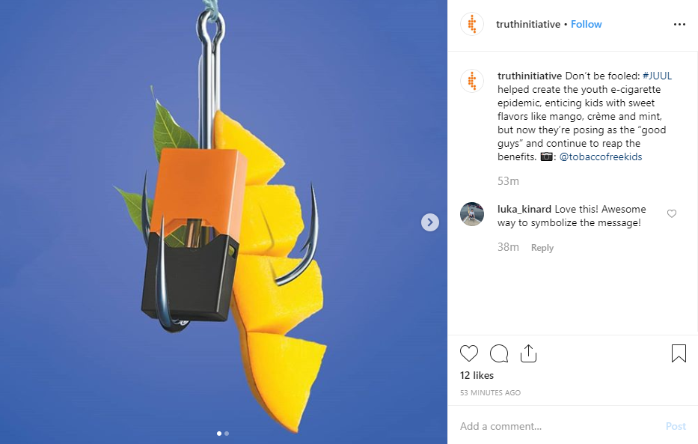
EXAMPLE ADS
Notes:
Activity 2: Real Talk: A Campaign - Part 2 (5 min.)
Share: This is an example campaign from Truth Initiative regarding the flavors used in e-cigarettes. There are two images that tie the same message together and give the facts and like t
Note to instructors - this part can be reserved for the start of session 4 or as an out of class assignment.
CASEL Competencies Covered
Self-awareness - identifying emotions, accurate self-perception
Self-management - organizational skills
Social awareness - perspective taking, respect for others, empathy, appreciating diversity
Relationship skills - communication, social engagement, teamwork
Responsible decision-making - identifying problems, analyzing situations, reflecting

Slide 30
EXAMPLE ADS
Notes:
Activity 2: Real Talk: A Campaign - Part 2 (5 min.)
Explain: You will use the true description you created in Part 1 to help you plan three social media posts around NOT smoking e-cigarettes (or preventing young people from starting)
The posts should be aimed at someone younger than you - and all for the same platform (SnapChat, Instagram, TikTok, etc.).
Note to instructors - this part can be reserved for the start of session 4 or as an out of class assignment.
CASEL Competencies Covered
Self-awareness - identifying emotions, accurate self-perception
Self-management - organizational skills
Social awareness - perspective taking, respect for others, empathy, appreciating diversity
Relationship skills - communication, social engagement, teamwork
Responsible decision-making - identifying problems, analyzing situations, reflecting

Slide 31
REMEMBER...
Notes:
Closing 1 minute:
Review that the point of ads is to sell, not to be truthful.
Remind students that they should be critical of ALL advertisements (including e-cigarette ads) and it is okay to do more research to make the best decision for yourself.
Note: All photos (except advertisements) from Pixabay unless otherwise cited.

