Slide 1
SESSION 4
YOUR LIFE. YOUR CHOICE.
© 2019 The University of Texas Health Science Center at Houston. All rights are reserved. CATCH® is a registered trademark of The Regents of the University of California.

Slide 2
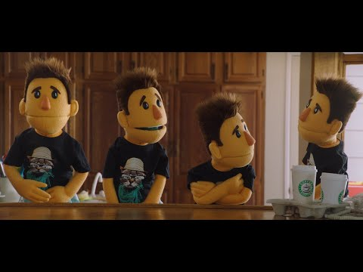
FOUR TIMES
Notes:
Watch “4x” From the Truth Initiative. (0:30 min)
Explain to students that by using e-cigarettes, you are priming your brain for a nicotine craving, and are FOUR TIMES more likely to use BOTH e-cigarettes AND regular cigarettes.
Link: https://youtu.be/wr8AsbPMSjM

Slide 3
WHAT HAVE YOU LEARNED?
What information about E-cigarettes stood out to you most over the course of this program?
With all this new information, do you feel more comfortable to make your own choice about e-cigarette use?
Notes:
Direct Instruction (5 min.)
Ask students which information about E-cigarettes stood out to them most over the course of the four 4 sessions. Compile a class list.
Class poll: With all this new information, do you feel more empowered to make your own choice about E-cigarette use?
CASEL Competencies Covered
Self-awareness - identifying emotions, accurate self-perception, self-confidence, self-efficacy
Social awareness - perspective-taking, empathy, appreciating diversity, respect for others
Relationship skills - communication, social engagement, relationship-building, teamwork
Responsible decision-making - identifying problems , analyzing situations, solving problems, evaluating, reflecting, ethical responsibility

Slide 4
SMALL GROUPS, ASSEMBLE!
Notes:
Ask the students to assemble into their numbered groups.

Slide 5
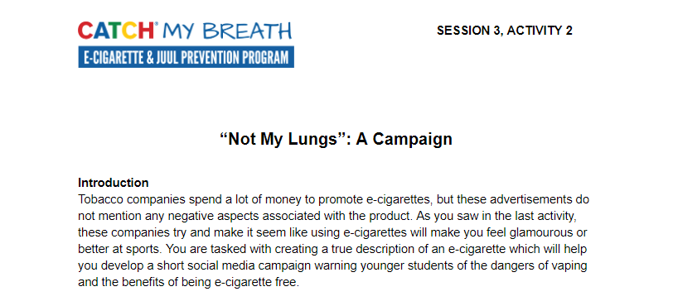
SESSION 3: NOT MY LUNGS
Notes:
Work Time (15 min.)
Continue work on Session 3, Activity 2: Not My Lungs: A Campaign.
CASEL Competencies Covered
Self-awareness - identifying emotions, accurate self-perception
Self-management - organizational skills
Social awareness - perspective taking, respect for others, empathy, appreciating diversity
Relationship skills - communication, social engagement, teamwork
Responsible decision-making - identifying problems, analyzing situations, reflecting

Slide 6
SESSION 3: REAL TALK
Pull out your Session 3, Activity 2 worksheet and finalize your social media campaign
Keep these points in mind:
You will use your true description of an e-cigarette from Part I
These posts could be just text, use images, or videos, or all three
Think of the platform you will use (SnapChat, Instagram, TikTok, etc.) as you are planning
Notes:
Work Time (15 min.)
Continue work on Session 3, Activity 2: Not My Lungs: A Campaign.
CASEL Competencies Covered
Self-awareness - identifying emotions, accurate self-perception
Self-management - organizational skills
Social awareness - perspective taking, respect for others, empathy, appreciating diversity
Relationship skills - communication, social engagement, teamwork
Responsible decision-making - identifying problems, analyzing situations, reflecting

Slide 7
PRESENTATION IS EVERYTHING!
Notes:
Presentations (10 min): Groups will briefly present their advertising slogan and hashtag.
CASEL Competencies Covered
Self-awareness - identifying emotions, accurate self-perception
Self-management - organizational skills
Social awareness - perspective taking, respect for others, empathy, appreciating diversity
Relationship skills - communication, social engagement, teamwork
Responsible decision-making - identifying problems, analyzing situations, reflecting

Slide 8
YOU ARE A ROLE MODEL
Notes:
Ask students: (3 mins)
What would your younger siblings/younger students think if they saw you smoking an e-cigarette?
How would you feel about your younger cousins or siblings getting hold of or smoking an e-cigarette?
CASEL Competencies
Self-awareness - accurate self-perception, self-confidence
Social awareness - perspective-taking, respect for others
Relationship skills - communication, social engagement, relationship-building
Responsible decision-making - evaluating, reflecting, ethical responsibility

Slide 9
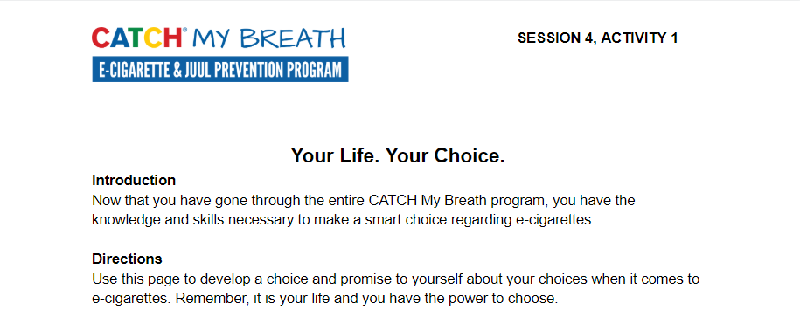
ACTIVITY 1: YOUR LIFE. YOUR CHOICE.
Notes:
Closing (5 min.)
Remind students that they are in control of their own choices and goals.
Distribute Your Life Your Choice handout and have students write down their choice about E-cigarettes and reasons for their choice.
Ask volunteers to read aloud their reasons to not use E-cigarettes.
CASEL Competencies
Self awareness - accurate self-perception, recognizing strengths, self-confidence, self-efficacy
Self-management - impulse control, stress management, self-discipline, self-motivation, goal-setting, organizational skills
Social awareness - perspective-taking, empathy, appreciating diversity, respect for others
Relationship skills - communication, social engagement, relationship-building, teamwork
Responsible decision-making - identifying problems, analyzing situations, solving problems, evaluating, reflecting, ethical responsibility

Slide 10
ACTIVITY 1: YOUR LIFE. YOUR CHOICE.
Take the next few minutes to carefully think about your choice regarding e-cigarettes.
Remember, this is YOUR choice (and only yours).
Notes:
Closing (5 min.)
Ask students to take the next few minutes to think critically and respond to the questions listed on their worksheet. It is okay if they need more time to finish the activity after class
Remind students that this choice is about their lives, not their classmates or friends or parents. They need to make this decision for themselves
Ask for students to volunteer to share their choice (if there is time in class)
CASEL Competencies
Self awareness - accurate self-perception, recognizing strengths, self-confidence, self-efficacy
Self-management - impulse control, stress management, self-discipline, self-motivation, goal-setting, organizational skills
Social awareness - perspective-taking, empathy, appreciating diversity, respect for others
Relationship skills - communication, social engagement, relationship-building, teamwork
Responsible decision-making - identifying problems, analyzing situations, solving problems, evaluating, reflecting, ethical responsibility

Slide 11
CONGRATULATIONS!
Notes:
Congratulate students on completing the CATCH My Breath Youth E-cigarette Prevention Program.
Explain: You have completed the CATCH My Breath Youth E-cigarette Prevention Program.
You now have all the information you need to make informed choices about E-cigarette usage.

