Slide 1
SESSION 1
DESIGNED FOR ADDICTION
© 2019 The University of Texas Health Science Center at Houston. All rights are reserved. CATCH® is a registered trademark of The Regents of the University of California.
Notes:
Suggested length: 35 minutes
Instructors: Please refer to the Educator 411: Additional Resources for more information on each topic covered in these lessons.

Slide 2
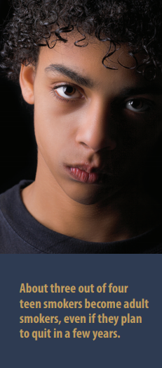
WHAT IS CATCH MY BREATH?
Notes:
Introduction (2 mins.)
CATCH My Breath is a program about e-cigarettes and tobacco. It includes four 35 mins. sessions and Peer Group Facilitated activities to help you:
Identify the consequences of using e-cigarettes.
Understand the highly-addictive nature of nicotine.
Learn strategies used by the tobacco industry to get teens addicted to nicotine and other products.
Co-Create and participate in the conversation about tobacco and e-cigarettes policies.
CVS Health and the CVS Health Foundation started the #BeTheFirst campaign in the hopes of fostering the first tobacco-free generation.
Photo Source: https://www.surgeongeneral.gov/library/reports/50-years-of-progress/consumer-guide.pdf
CVS: https://cvshealth.com/social-responsibility/be-the-first

Slide 3
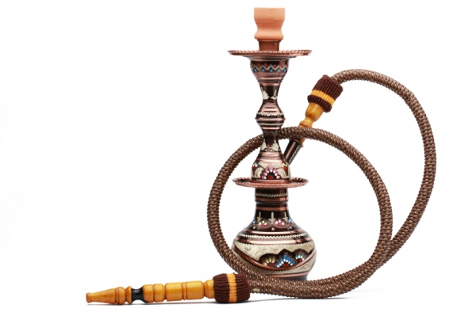
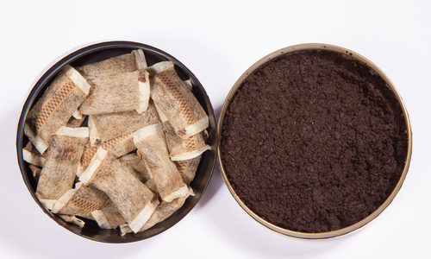
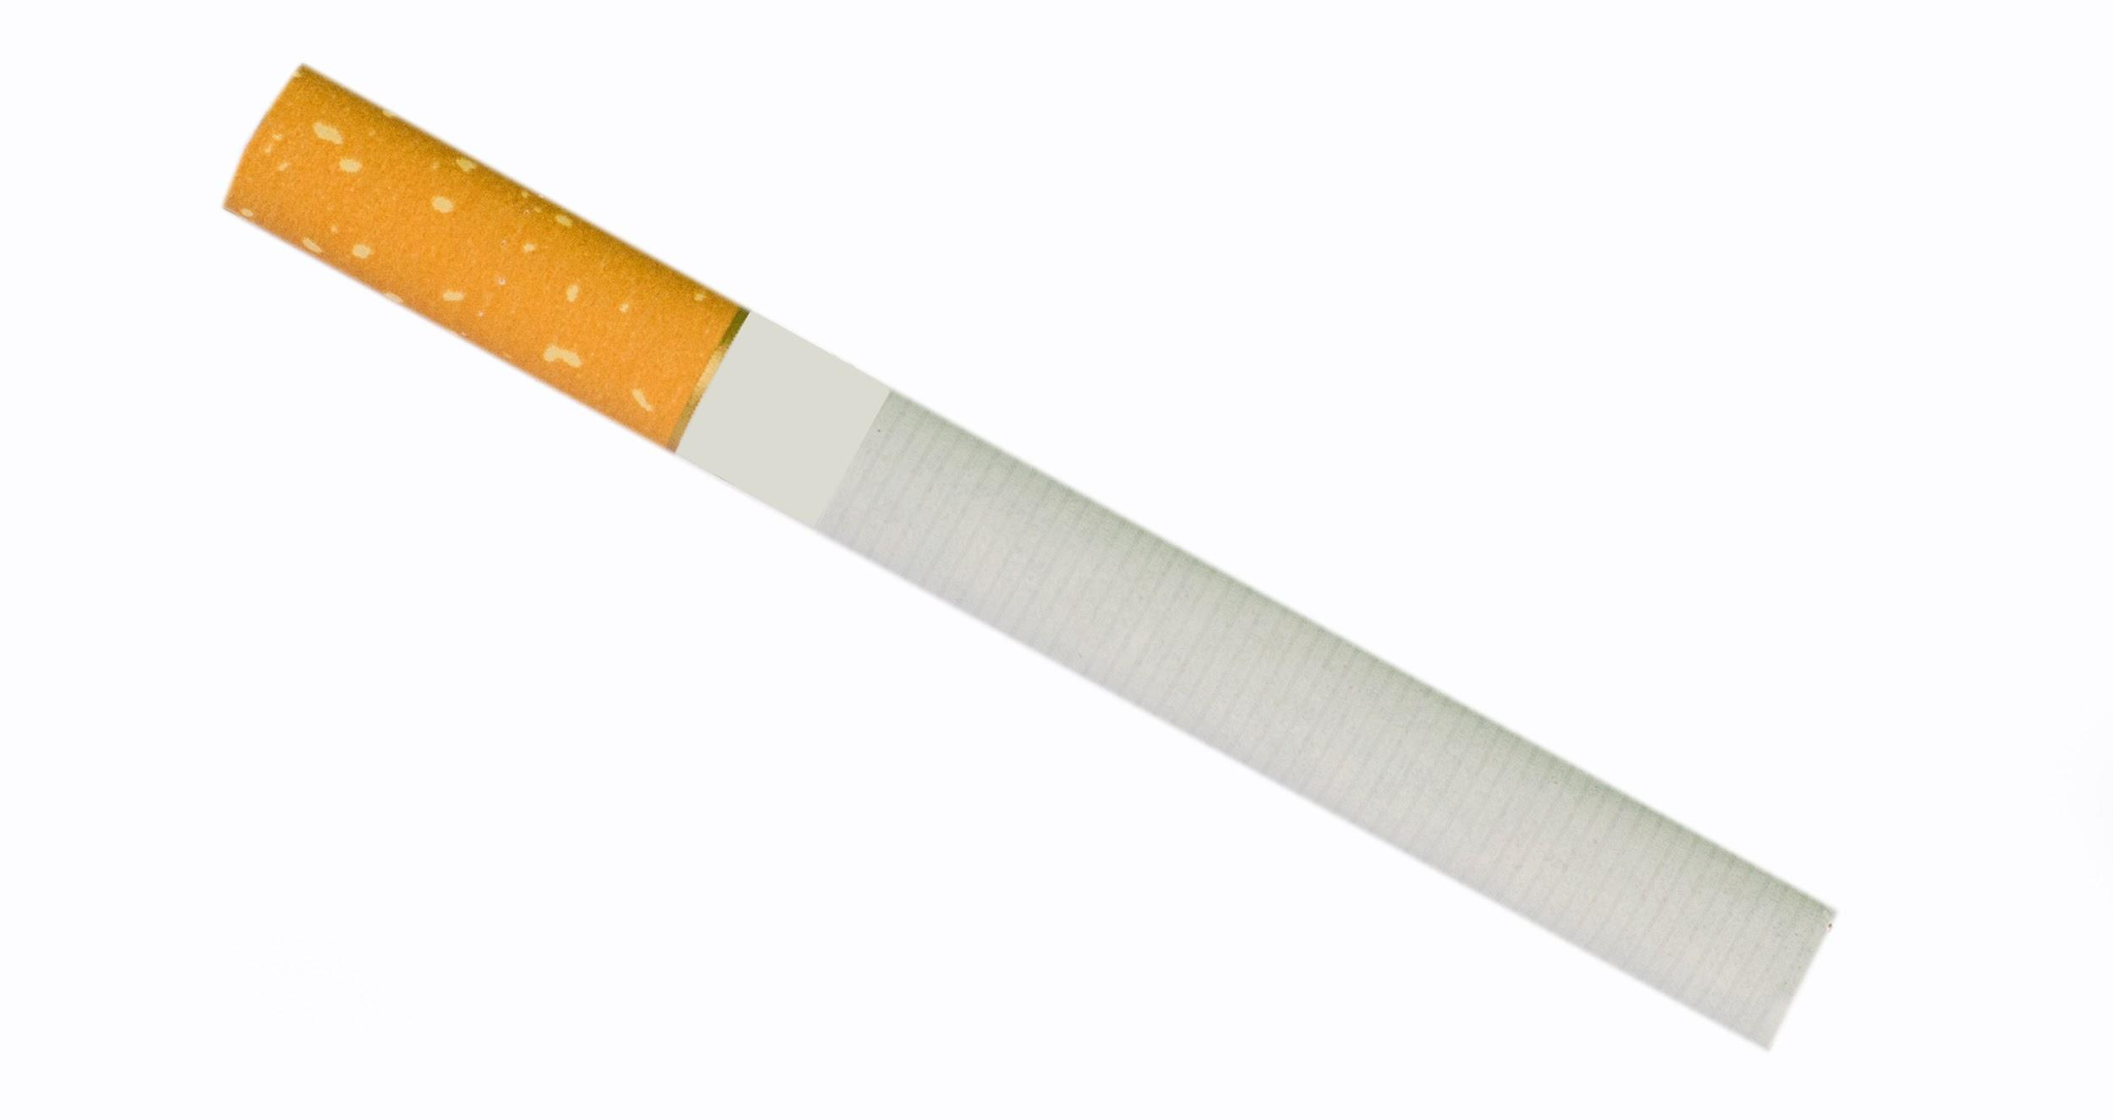
TOBACCO AND NICOTINE 101
Combustible tobacco
Smokeless tobacco
E-cigarettes
Heat-not-Burn
What do all of these products have in common?
Notes:
Direct Instruction (20 minutes)
Tobacco/Nicotine products are divided into four categories:
Combustible tobacco: Cigarettes, Cigars, Hookah, Cigarillos, Roll your own.
Smokeless tobacco: Chew, Snuff, Snus.
E-cigarettes: Disposable, Tank, Cartridge.
Heat-not-burn:heat sticks.
Ask students What do all these products have in common?
Reveal the answer Nicotine!
Image sources.
NIDA. 7.2.19 https://teens.drugabuse.gov/blog/post/problems-nicotine
Truth initiative 7.2.19 https://truthinitiative.org/research-resources/emerging-tobacco-products/what-are-heat-not-burn-cigarettes

Slide 4
FROM BAD TO WORSE
All forms of tobacco are HARMFUL.
Most Harmful
Cigarette
Cigar
Hookah
Smoke- less Tobacco
Heat Not Burn
E-Cigs
Safest
Clean Air
Notes:
Explain: Although E-cigarettes are less harmful compared to other tobacco products (e.g. combustible cigarette), they are still very HARMFUL. Every form of tobacco products can cause harm to nearly every organ in your body. It can also lead to heart disease, stroke, eye problems, and yellow teeth. Each of these products we talked about come with their own issues:
Combustible tobacco e.g. cigarettes, cigars, hookah, cigarillos, roll your own, can cause lung, mouth, stomach, kidney, and bladder cancers
E-cigarettes of all types, including JUUL, contain nicotine which is a highly addictive drug. Although e-cigarettes seem to be less harmful than combustible tobacco, the aerosol that users inhale have other harmful substances, including heavy metals, volatile organic compounds, and ultrafine particles that cause irreversible damage to the lungs. They also contain as much as or more nicotine than a regular cigarette.
Smokeless tobacco e.g. Chew, Dip, Snuffs can cause cancer of the mouth, esophagus, and pancreas.
Heat-not-burn e.g. IQOS heat sticks or Glo, are considered a harm reduction product. The long term effects are not well known, but they contain a lower level of carcinogenic chemicals compared to combustible tobacco.
CASEL Competencies Covered
Self-awareness - identifying emotions, accurate self-perception
Responsible decision-making - identifying problems, analyzing situations, evaluating, reflecting, ethical responsibility

Slide 5
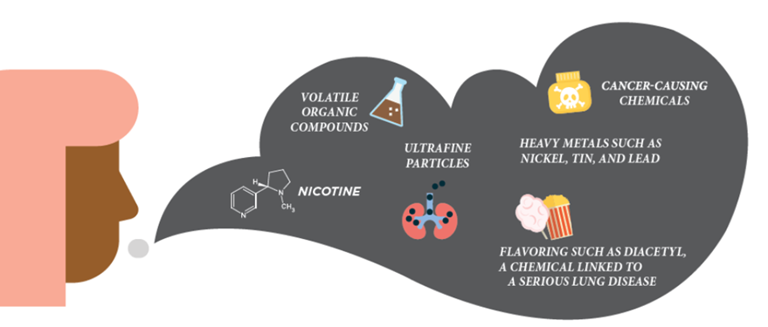
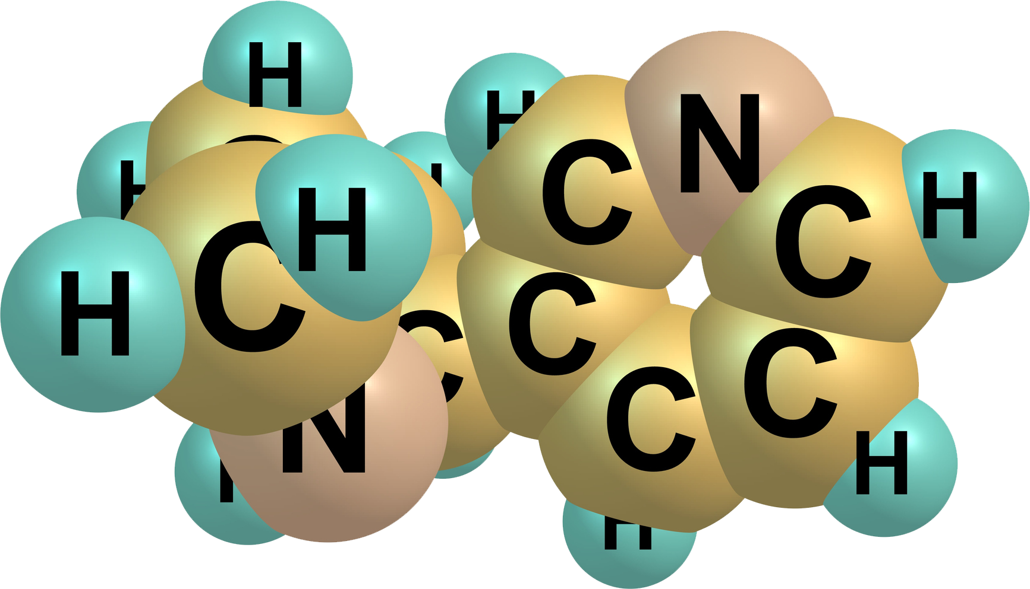
NOT HARMLESS...
Notes:
Explain: E-cigarettes are considered safer than cigarettes, but they’re far from safe. They’re a toxic mix of highly-addictive nicotine and other chemicals like:
Acetaldehyde: causes mutations in reproductive cells, possibly causes genetic defects, is a class 2 carcinogen (causes cancer), and is a class 2 specific target organ toxin.
Acrolein: may cause frequent lung infections & general deterioration of health due to an accumulation in one or many human organs.
Not to mention other chemicals like 2,3-pentanedione, propylene glycol, heavy metals (like lead and nickel), volatile organic compounds, and ultrafine particles which harm the lungs. AND more than 8,000 flavor chemicals used in the different e-liquids have NOT been tested for use in the lungs.
Chemical structure of nicotine consist of carbon, nitrogen and hydrogen (C10H14N2)
Molecule image from IStock - Kelder owner.

Slide 6
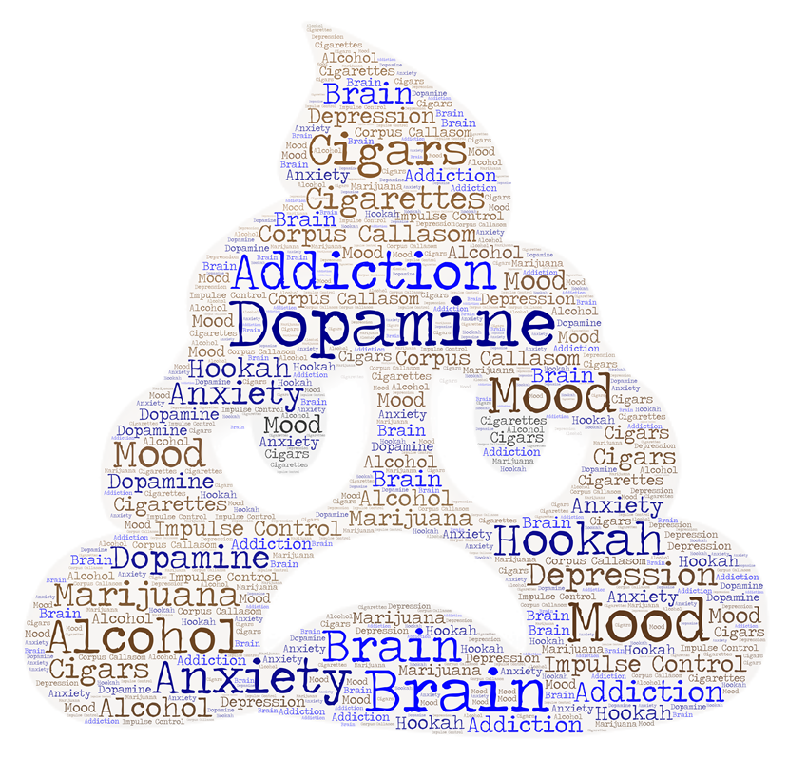
THE NICOTINE PATHWAY
Nicotine is addictive.
Nicotine activates the dopamine reward system and make you “feel good”.
Nicotine hacks your brain by pretending to be natural brain chemicals.
When nicotine wears off, you become anxious, moody, and nervous.
Nicotine addiction causes varying mood disorders.
Once addicted to nicotine, other drugs can use the nicotine reward pathway, making it easier to become dependent on other drugs.
Notes:
EXPLAIN:
Pathway to nicotine addiction: When you smoke a tobacco product, nicotine gets into the blood through the lungs, then travels to the brain where it hacks into the brain by pretending to be a natural brain chemical. It then activates the dopamine reward system (which is responsible for pleasure) in the brain. Overstimulation of this pleasure system in the brain leads to addiction.
Consequences of Nicotine include:
Nicotine is very addictive especially to the developing brain of teens.
Nicotine users experience varying degree of mood disorders including anxiety, moodiness, nervousness (signs of nicotine addiction and withdrawal)

Slide 7
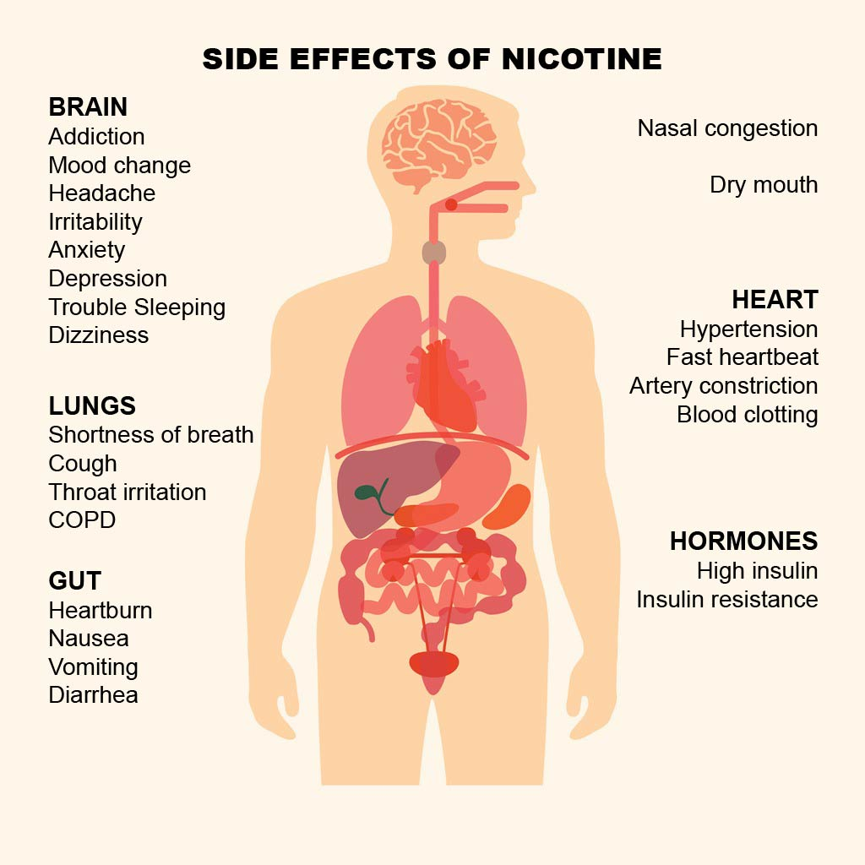
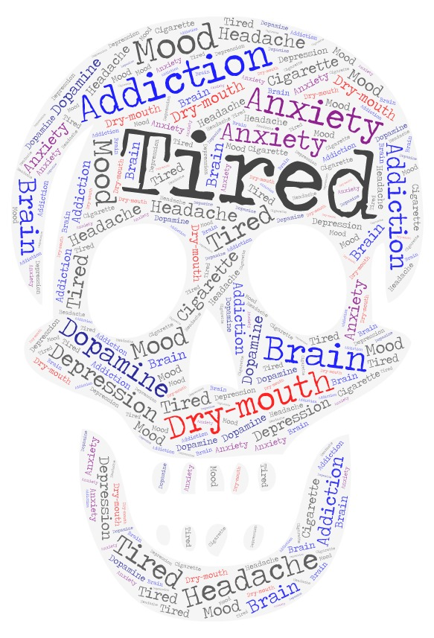
EFFECTS OF NICOTINE ON THE BODY
Notes:
Explain: Nicotine causes harm to many organs in the body that includes brain, lungs, heart, Gastrointestinal tract, joint, causing:
Ear, Nose & Throat: nose congestion, dry Mouth
Brain: addiction, mood change, headache. irritability, anxiety, depression, trouble sleeping, dizziness
Lungs: shortness of breath, cough, throat irritation, COPD (chronic obstructive pulmonary disease)
Heart: hypertension, fast heartbeat, artery constriction, coronary artery disease.
Gut: heartburn, nausea, vomiting, diarrhea, dyspepsia (indigestion)
Hormones: high insulin (low blood sugar), insulin resistance (causing to type 2 diabetes)
Image Sources. iStock - Kelder owned
CASEL Competencies Covered
Self-awareness - identifying emotions, accurate self-perception
Responsible decision-making - identifying problems, analyzing situations, evaluating, reflecting, ethical responsibility

Slide 8
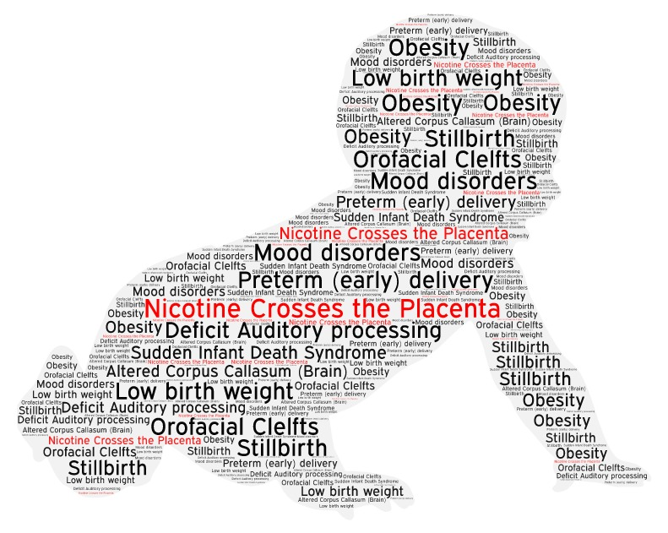
NICOTINE IS BAD FOR BABIES
Notes:
Explain: Nicotine can cause a number of birth complications. The worst are stillbirth, which is when the baby is dead at birth, and Sudden Infant Death Syndrome, when the infant dies in its first few months. When a pregnant woman uses anything with nicotine in it, the nicotine also gets to the baby. Nicotine is extremely harmful to the developing fetus and the harms increase as the baby grows. When pregnant moms use nicotine, it is more likely that there will be significant problems. Nicotine‐exposed babies tend to have several health problems throughout their lives, including impaired function of the endocrine, reproductive, respiratory, cardiovascular, and neurologic systems.
Babies who were exposed to nicotine in utero tend to grow up to have poor long term academic performance and behavioral problems such as ADHD, aggressive behaviors, and future substance abuse.
In babies exposed to nicotine it is associated with poor long term academic performance and significant behavioral disruptions are also common, including ADHD, aggressive behaviors, and future substance abuse.
Sources: https://www.cdc.gov/tobacco/data_statistics/sgr/e-cigarettes/index.htm
Holbrook, B. D. (2016). The effects of nicotine on human fetal development. Birth Defects Research Part C: Embryo Today: Reviews, 108(2), 181-192.
For more information about nicotine and pregnancy see https://www.marchofdimes.org/pregnancy/smoking-during-pregnancy.aspx
CASEL Competencies Covered
Self-awareness - identifying emotions, accurate self-perception
Responsible decision-making - identifying problems, analyzing situations, evaluating, reflecting, ethical responsibility

Slide 9
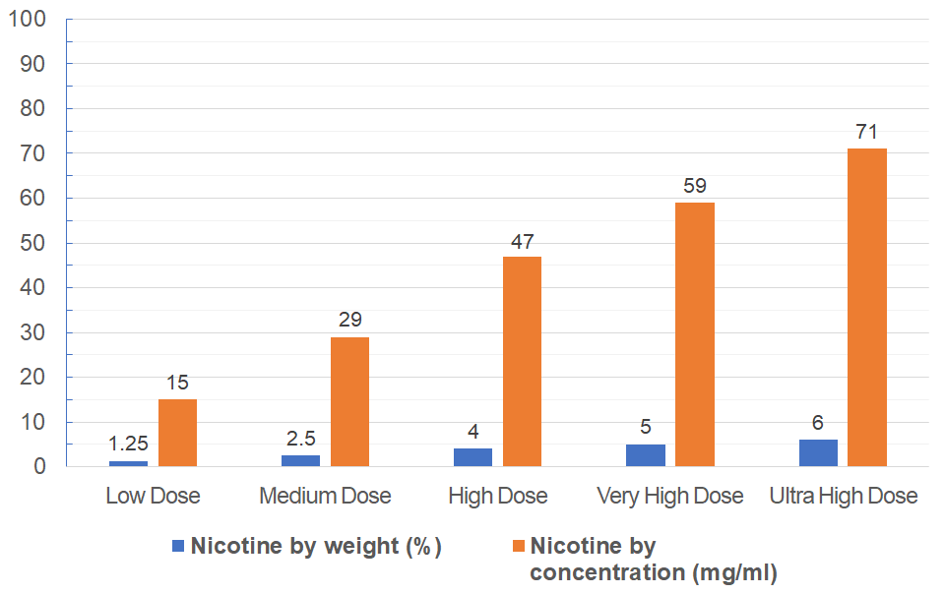
HOW MUCH IS TOO MUCH?
JUUL
Notes:
Ask: Why e-cigarette companies use such high amounts of nicotine?
Reveal:. The higher the dose, the faster the nicotine gets to the brain, and the faster addiction occurs
Explain: nicotine can be measured using two different units:
Nicotine by weight (%) OR
Concentration (mg/ml) (most commonly used)
A few years ago, most e-cigarette brands contain between 3mg/ml and 30 mg/ml which is equivalent to 0.25 -2.5% nicotine by weight. The 30 mg/ml was intended for heavy smokers.
Today, the most popular brand is JUUL contains 59 mg/ml (or 5% by weight) of nicotine, (VERY HIGH nicotine content).
Note that 60 milligrams (mg) of nicotine can be deadly. ONE teaspoon of nicotine can be fatal to toddlers.
Additionally, 20mg/ml is the non-prescription maximum in Europe (indicated by the blue horizontal line on the graph)
Mixtures can be described in several ways. Mass per mass, mass per volume and volume per volume. Volumes of materials vary with temperature, so the mass per volume measure should be treated with caution. Supposing that a given volume of water weighs a particular mass, its at best an approximate. Mass is in general invariant. MG is milligram mass. Ml is milliliter volume.
That is an abbreviation for milligrams per milliliter: Milliliter is a measure of volume which equals one thousandth of a liter.Milligram is a measure of mass equal to one thousandth of a gram.
Molecule image from IStock - Kelder owner.

Slide 10
WANT TO LOOK LIKE HIM?
Notes:
Ask students to raise their hand if they want to become the next generation of smokers to replace those that have died.
Explain: There is a high chance that this man started smoking as a teenager. Nearly all adults who smoke started when they were teenagers. Tobacco companies don't care about you. They just want you to give them your money.
Image source: iStock, Kelder Owner

Slide 11
ANNOUNCING YOUR NEW TEAM!
Notes:
Announce Peer Group Facilitators and group assignments.
Ask students to assemble into their groups.
Instruct Peer group facilitators to divide their group into 2 groups.
CASEL Competencies Covered
Social awareness - perspective taking, respect for others
Relationship skills - communication, social engagement, relationship building, teamwork

Slide 12
ACTIVITY 1: NEGATIVE CONSEQUENCES OF USING E-CIGARETTES
Peer Group Facilitators: Split your group in two
One half of the group
Use scratch paper (or notecard) to list health consequences of using e-cigarettes.
The other half of the group
Use scratch paper (or notecard) to list social consequences related to social relationships, family relationships, personal identity and goals.
Switch papers within your group and add anything that may have been left out.
Notes:
Activity 1: Consequences of E-cigarette Use (5-10 min.)
Distribute an index card or square of paper to each student.
Explain: You will be brainstorming consequences of E-cigarette use in your groups:
One half of the group will list health consequences of using e-cigarettes.
The other half of the group will list social consequences of using e-cigarette e.g. consequences related to social situation, family, personal identity and goals.
You will switch cards/papers with the opposite group to fill in any gaps for possible responses
Remind students that there are no wrong answers
CASEL Competencies Covered
Responsible decision-making - identifying problems, analyzing situations, evaluating, reflecting, ethical responsibility
Self-awareness - identifying emotions, accurate self-perception, self-confidence
Relationship skills - communication, social engagement

Slide 13
ACTIVITY 1: NEGATIVE CONSEQUENCES OF USING E-CIGARETTES
Health Consequences:
Aerosol has toxic chemicals that can damage the lungs.
Hacks your brain (dopamine reward system, impulse control center)
Nicotine causes addiction
Dry mouth, Vapor tongue, Sore throat, Nose bleed
Nicotine toxicity: nausea, headache, increased heart rate
Can be fatal for babies: SIDS, stillbirth, low birthweight
Batteries explode
Gateway to combustible tobacco, alcohol and marijuana and other addictive drugs.
Ingesting e-liquid can be FATAL.
Notes:
Activity 1: Consequences of E-cigarette Use (5-10 min.)
Share at least one example from each group
Reveal examples of health consequences on the slide that were not mentioned in the groups
CASEL Competencies Covered
Responsible decision-making - identifying problems, analyzing situations, evaluating, reflecting, ethical responsibility
Self-awareness - identifying emotions, accurate self-perception, self-confidence
Relationship skills - communication, social engagement

Slide 14
ACTIVITY 1: NEGATIVE CONSEQUENCES OF USING E-CIGARETTES
Social Consequences:
Costs a lot of money, about $50 to get started
Cartridge pods cost $3- $7 (per pod)
Get suspended from sports
Bad role model to younger family members
Get in trouble at school or at home.
Get in trouble with the law (Purchasing or possession is against the law under 18 or 21 depending on state)
Lose the trust of parents
Notes:
Activity 1: Consequences of E-cigarette Use (5-10 min.)
Share at least one example from each group
Reveal examples of health consequences on the slide that were not mentioned in the groups
1 pod a day = $1,000 per year
½ pod a day = $546 per year
CASEL Competencies Covered
Responsible decision-making - identifying problems, analyzing situations, evaluating, reflecting, ethical responsibility
Self-awareness - identifying emotions, accurate self-perception, self-confidence
Relationship skills - communication, social engagement

Slide 15
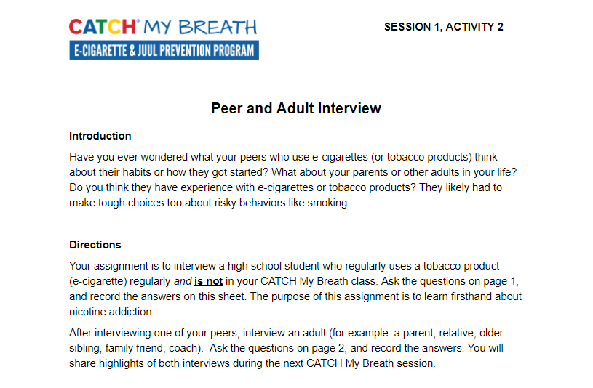
ASSIGNMENT: PEER & ADULT INTERVIEW
Notes:
Closing (2 min.)
Assign Activity 2: Adult and Peer Interviews.
Explain: You will interview one peer and one adult (parent, guardian, teacher, etc.) about their relationship with tobacco products. You will bring the completed interview to the next class to discuss.
The peer must be someone who currently uses a tobacco or e-cigarette product
The adult does not need to have ever used a tobacco or e-cigarette product.
CASEL Competencies Covered
Self-awareness - self-confidence, self-efficacy
Self management - self-motivation, stress management, goal-setting, organizational skills
Social awareness - empathy, perspective-taking, appreciating diversity, respect for others
Relationship skills - communication, social engagement, relationship-building
All photos sourced from Pixabay unless otherwise cited.

