Slide 1
SESSION 2
WHAT COULD GO WRONG?
© 2019 The University of Texas Health Science Center at Houston. All rights are reserved.
CATCH® is a registered trademark of The Regents of the University of California.
Notes:
Suggested length: 35 minutes

Slide 2
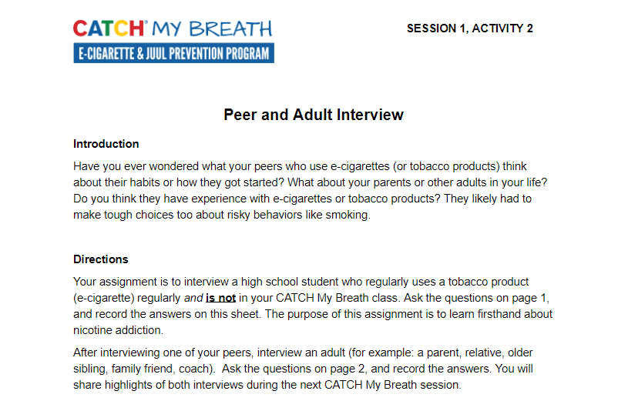
PEER & ADULT INTERVIEW DEBRIEF
Notes:
Introduction (5 min.)
Ask students to bring out Session 1, Activity 2: Peer & Adult Interview. Ask the following questions:
Peer Interview
Why did your peers try e-cigarette?
What did your peers who smoke say about craving and addiction?
Are they trying to quit?
Adult Interview
What advice for resisting pressure to try e-cigarette did adult give?
What are the reasons the adults gave for not using tobacco (or quitting)?
CASEL Competencies Covered
Self-awareness - self-confidence, self-efficacy
Self management - self-motivation, stress management, goal-setting, organizational skills
Social awareness - empathy, perspective-taking, appreciating diversity, respect for others
Relationship skills - communication, social engagement, relationship-buildingg

Slide 3
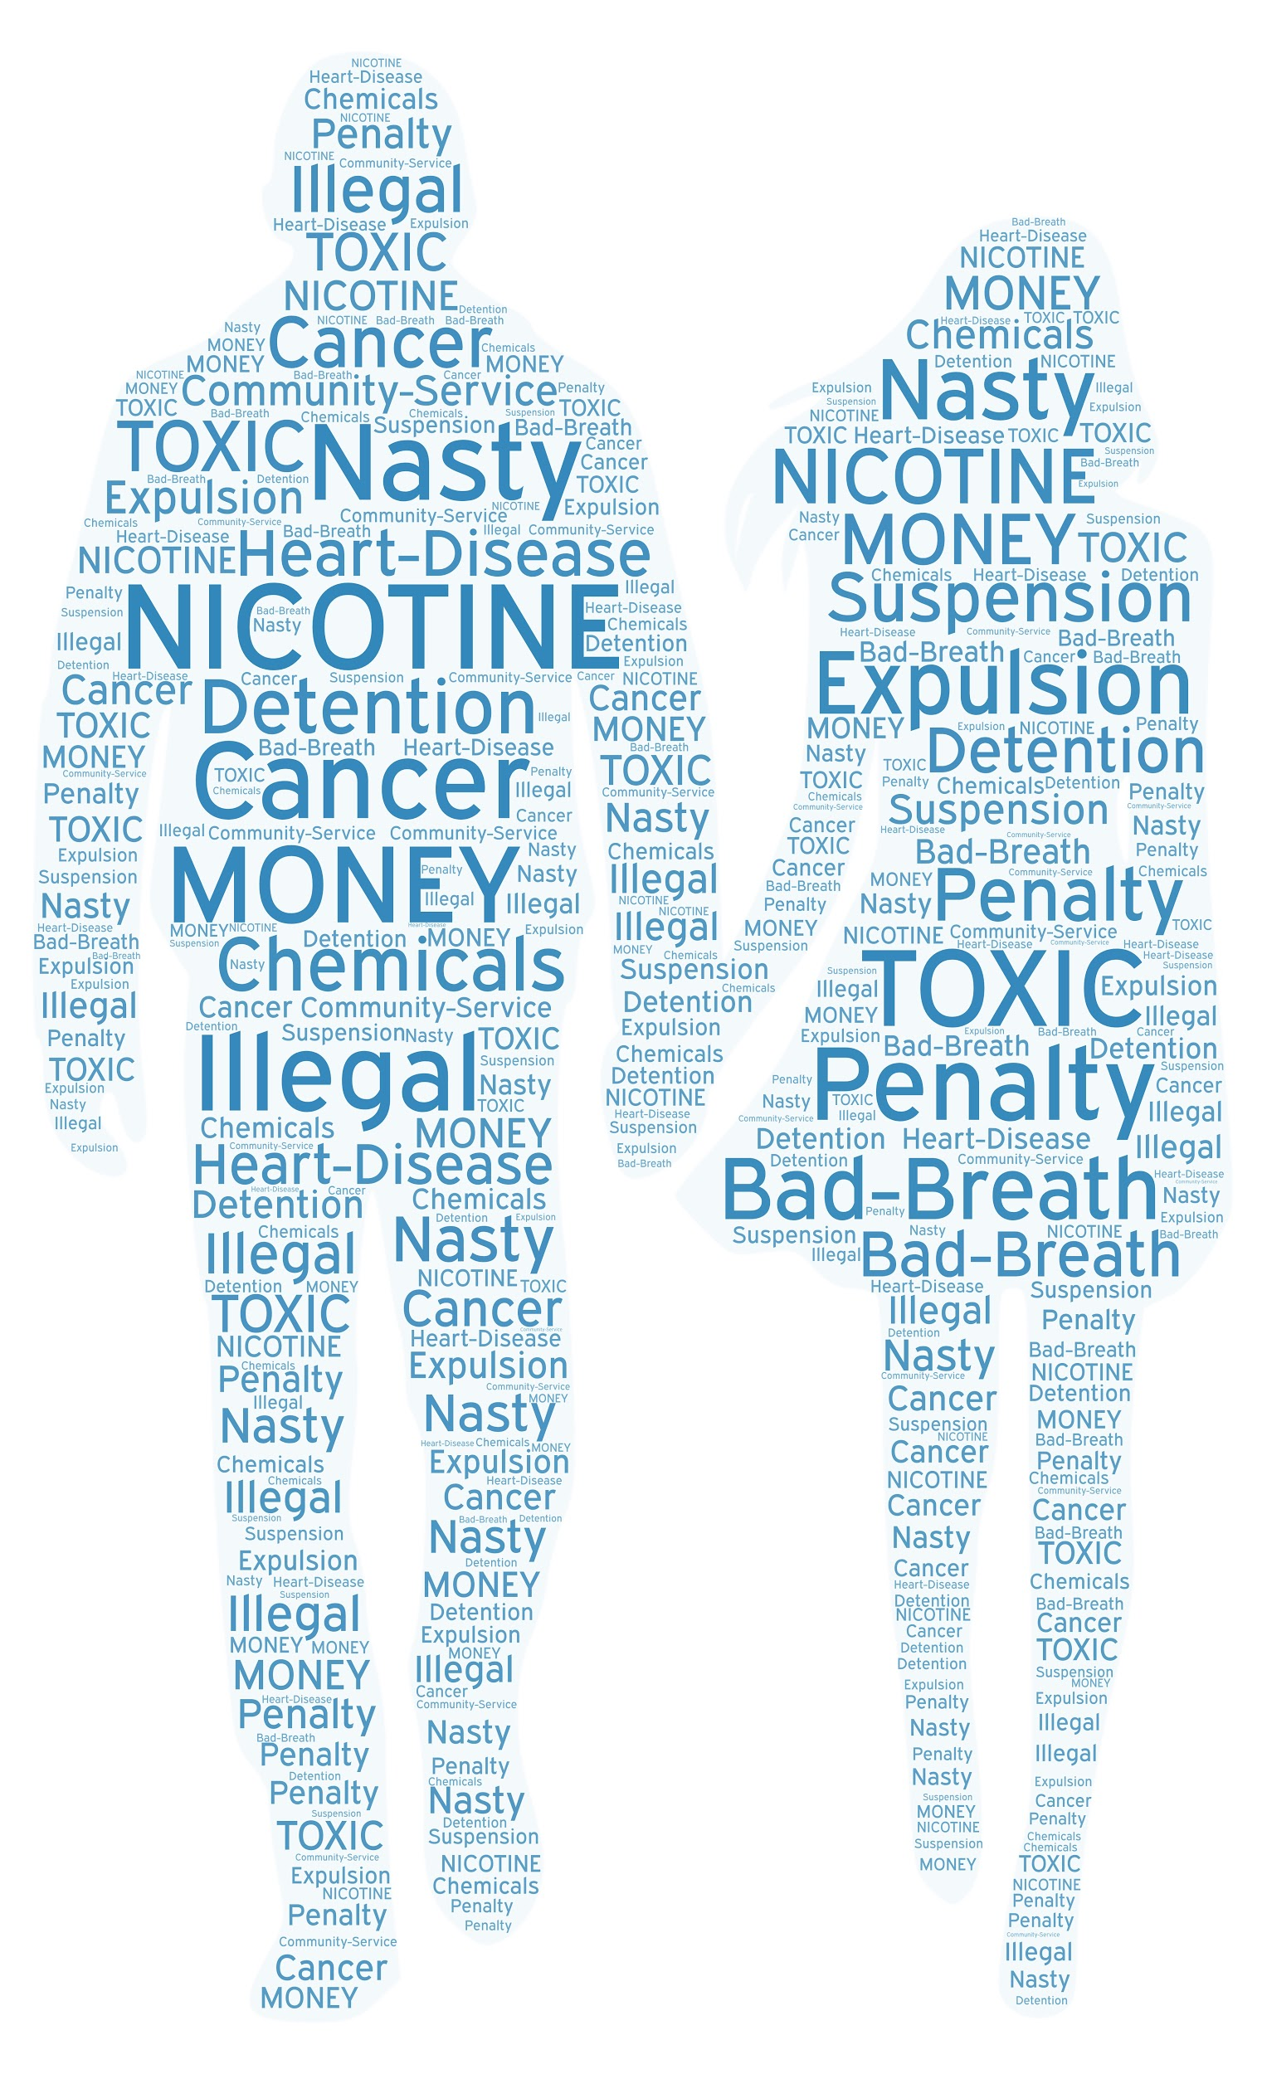
CONSEQUENCES ABOUND
Notes:
Direct Instruction (10 minutes)
Remind students that almost all tobacco products contains Nicotine, this includes: e-cigarettes, cigarettes, cigars, chew, hookah.
Reinforce the Health & Social Consequences of E-cigarette use from the previous lesson
Health Consequences include:
Aerosol has toxic chemicals that can damage the lungs.
Hacks brain circuitry (dopamine reward system, impulse control center)
Nicotine causes addiction
Dry mouth, Vapor tongue, Sore throat, Nose bleed
Nicotine toxicity, nausea
Can be fatal for babies (SIDS). Low birthweight
Batteries explode
Gateway to combustible tobacco, alcohol and marijuana and other addictive drugs.
Ingesting e-liquid can be FATAL.
Social Consequences:
Costs a lot of money, about $50 to get started
Cartridge pods cost $3-7
Get suspended from sports
Bad role model to younger siblings
Get in trouble at school or at home.
Get in trouble with the law (Purchasing or possession is against the law).
Lose the trust of parents
CASEL Competencies Covered
Responsible decision-making - identifying problems, analyzing situations, evaluating, reflecting, ethical responsibility
Self-awareness - identifying emotions, accurate self-perception, self-confidence
Relationship skills - communication, social engagement

Slide 4


ACTIVITY 1: WHAT HAVE YOU SEEN OR HEARD ABOUT E-CIGARETTES?
Seen?
Heard?
Notes:
Activity 1: What have you seen or heard about e-cigarette? (5 mins)
Distribute index cards or paper squares to each student.
Ask students to record responses to the following question on their index card: What have you seen or heard about e-cigarettes?
Stress that there are no wrong answers and they do NOT need to include their name on the index card
Read responses aloud to the class.
List students' answers on the board.
Reveal the possible answers:
Everybody is doing it.
Some people smoke in class
People vape in the bathroom
My friends’ parents vape and say it’s safe
It’s illegal, but I can get it at schools
Would you rather I smoke pot?
Fruit flavors don’t have nicotine
Share the following facts to students:
Half of E-cigarette users don’t know the health and social consequences associated with e-cigarette use.
More than half of E-cigarette users aren't aware that flavored e-juice contains nicotine.
Two-thirds of U.S. teenage JUUL users don’t know it contains nicotine.
CASEL Competencies Covered
Self-awareness - identifying emotions, accurate self-perception, self-confidence, self-efficacy
Self-management - stress management, self-discipline, organizational skills
Social awareness - perspective-taking, empathy, respect for others
Relationship skills - communication, social engagement
Responsible decision-making - identifying problems, analyzing situations, evaluating, reflecting

Slide 5

KNOWLEDGE IS POWER
More than 50% of teens think fruit and candy flavored e-liquid don’t contain nicotine
Approximately two-thirds of teens don’t think JUUL contains nicotine
If you were addicted, wouldn’t you want help from a friend?
Notes:
Explain: Most people who use E-cigarettes don’t have the information you have. Almost half of current users didn’t believe there were any health risks at all. Sharing information is a better strategy than being mean or harsh about someone’s E-cigarette use.
There is positive reinforcement with nicotine addiction and physical dependence to avoid withdrawal symptoms.
Remember:
As someone uses a nicotine product, the chemical is absorbed into their system and mood and pleasure centers are aroused. The tolerance and physical dependence for the substance increases as use continues.
Going without nicotine can produce withdrawal symptoms as well as a craving for more nicotine.The cycle continues to repeat.
CASEL Competencies Covered
Self-awareness - identifying emotions, accurate self-perception
Social awareness - perspective-taking, empathy, respect for others
Sources:
Dobbs, P. D., Hammig, B., & Henry, L. J. (2017). E-cigarette use among US adolescents: Perceptions of relative addiction and harm. Health Education Journal, 76(3), 293-301.
https:///many-teens-don’t-know-juul-contains-addictive-nicotine.
https://www.yalemedicine.org/.stories/teen-vaping/
Photo from Burst.

Slide 6
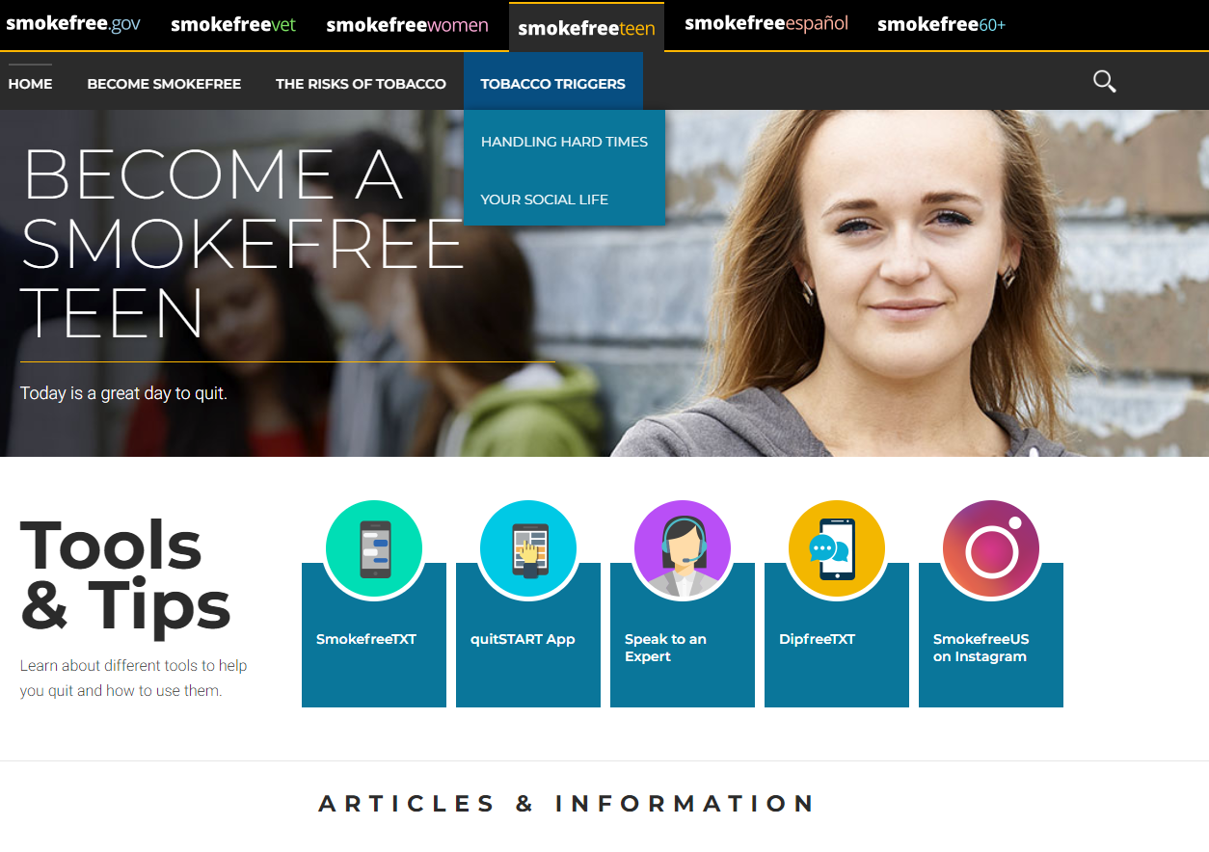
HELPING A FRIEND IS SIMPLE
https://teen.smokefree.gov
Notes:
Share: There are existing resources for you and your friends to use like teen.smokefree.gov. Do not hesitate to share this information with your friends and potentially save a life.
Note to teachers
The teen.smokefree.gov website has up-to-date and accurate resources from the National Cancer Institute. Do not hesitate to refer students to this website.
We have also included other accurate and approved resources below.
Other resources to help quit:
FDA-approved cessation products (1-800-QUIT NOW), a text-based program (text QUIT to 47848).
Centers for Disease Control and Prevention, Youth Tobacco Prevention. www.cdc.gov/tobacco/youth/index.htm.
Teens in nine states -- Colorado, Massachusetts, Michigan, Montana, North Dakota, Nevada, Ohio, Pennsylvania and Utah -- can call or text the helpline at 1-855-891-9989 or go online to mylifemyquit.com.
Truth Initiative- https://www.thetruth.com/articles/hot-topic/quit-vaping
CASEL Competencies Covered
Self-awareness - identifying emotions, accurate self-perception
Self-management - self-discipline, self-motivation, goal-setting
Social awareness - perspective-taking, empathy, respect for others
Relationship skills - communication, social engagement, relationship building
Responsible decision-making - identifying problems, analyzing situations, evaluating, reflecting, ethical responsibility

Slide 7

ASSEMBLE INTO SMALL GROUPS
Notes:
Work Time (15-20 mins.)
Ask students to assemble into their peer groups.
CASEL Competencies Covered
Social awareness - perspective taking, respect for others
Relationship skills - communication, social engagement, relationship building, teamwork

Slide 8
ACTIVITY 2: SIX WORD STORIES
Ernest Hemingway once wrote a six word story and called it his “best work”.
  For sale: baby shoes, never worn.
Some other examples
  Failed SAT. Lost Scholarship. Invented Rocket. -
  William Shatner
  Cryonics: Disney thawed. Mickey gnawed. Omigawd. -
  Eileen Gunn
  Corpse parts missing. Doctor buys yacht. - Margaret Atwood
  Dinosaurs return. Want their oil back. - David Brin
  Epitaph: He shouldn’t have fed it. - Brian Herbert
  Kirby had never eaten toes before. - Kevin Smith
Notes:
Activity 2: Six Word Stories (5-10mins)
Distribute: An index card or square of paper to each student.
Explain: Sometimes the most powerful stories are the shortest. Ernest Hemingway once wrote a six word story and called it his best work.
Instruct students to reflect on what they have seen or heard about e-cigarettes, and to brainstorm a six word story.
Assign one of the topics below to the different groups to inspire their six word story:
Reasons why young adults their age experiment with e-cigarettes?
Health consequences for using e-cigarettes?
Social consequences of using e-cigarettes?
Describe how an e-cigarette user might feel or behave when craving nicotine?
Calculate the cost of smoking one JUUL pod a day for 10 years. What could you buy?
Share: Call on each Peer Group Facilitator at a time to report on six word story inspired by the varied topics on e-cigarettes listed by their group and make a class list.
CASEL Competencies Covered
Self-awareness - identifying emotions, accurate self-perception
Self-management - organizational skills
Social awareness - perspective-taking, empathy, appreciating diversity, respect for others
Relationship skills - communication, social engagement, relationship-building, teamwork
Responsible decision-making - identifying problems, analyzing situations, solving problems, evaluating
This activity was inspired by a story in Wired Magazine. https://www.wired.com/2006/11/very-short-stories/

Slide 9

PREVIEW: SESSION 3
Adults make all the rules:
  Driving age
  Curfew
  Start and stop time of school
  Dress code and hair style
  Food served at school
  School curriculum
The next time we meet, you get to:
Improve the rules, laws and codes OR develop new ones to keep your peers safe & healthy.
Notes:
Explain to students that next session.
Before class, e-mail Handout X with school district and local, state and national rules.
Overview. This slide introduces a new activity where students work together in groups to:
Look up and read school district rules, state laws and education codes on tobacco and e-cigarettes.
List pros and cons of the current rules and regulations regarding tobacco and e-cigarettes.
Improve the rules, laws, codes, or develop new ones.
All photos (except advertisements) from Pixabay or Burst unless otherwise cited.

