Slide 1
SESSION 4
TAKE CONTROL OF YOUR LIFE.
© 2019 The University of Texas Health Science Center at Houston. All rights are reserved. CATCH® is a registered trademark of The Regents of the University of California.
Notes:
Suggested length: 35 minutes

Slide 2
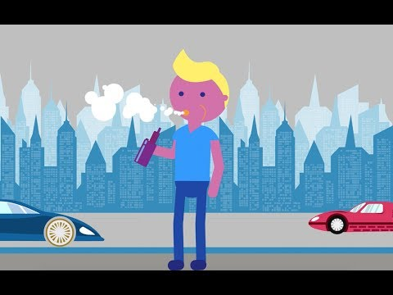
WHAT HAVE YOU LEARNED?
Notes:
Video: Electronic Cigarettes and Vaping from David Geffen School of Medicine UCLA (4 min)
Remind Students:
Tobacco smoking harms nearly every organ of the body, causes many diseases, and reduces the health of smokers.
Quitting smoking lowers your risk for smoking-related diseases and can add years to your life.
Cigarette smoking is the leading preventable cause of death in the United States.
Young people who smoke e-cigarettes become addicted to nicotine and eventually switch to regular cigarettes or become dual users , with harmful consequences.
link to video: https://www.youtube.com/watch?v=9dZS_Rniak0

Slide 3
ASSEMBLE INTO SMALL GROUPS
Notes:
Ask the students to assemble into their peer groups and divide themselves into the same subgroups as the last session.
CASEL Competencies Covered
Social awareness - perspective taking, respect for others
Relationship skills - communication, social engagement, relationship building, teamwork

Slide 4
TOBACCO & E-CIGARETTE LAW INVESTIGATION WRAP-UP
Peer Group Facilitators: Reconvene the teams from the previous class.
Review your ideas as a team.
Select 2 new rules and 2 improved rules and present them to the class.
Notes:
Work Time (10 min)
Session 3, Activity 2: Tobacco & E-cigarette Law Investigation
Instruct: teams to review ideas from previous session.
Team one: Select 2 new rules that apply to tobacco and e-cigarette.
Team two: Select 2 improved rules that apply to tobacco and e-cigarette.
Ask: one student from each team to share the two selected rules
CASEL Competencies Covered
Self-management - goal setting, organizational skills
Social awareness - perspective taking, appreciating diversity, respect for others
Relationship skills - communication, social engagement, relationship building, teamwork
Responsible decision-making - identifying problems, analyzing situations, solving problems, evaluating, reflecting, ethical responsibility

Slide 5
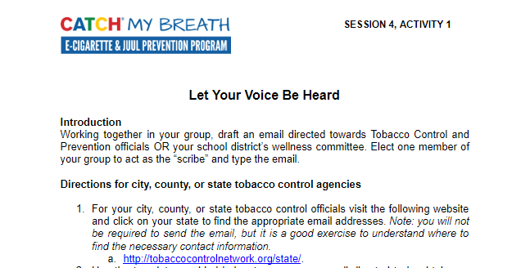
ACTIVITY 1: LET YOUR VOICE BE HEARD
Notes:
Session 4, Activity 1: Let Your Voice Be Heard
Ask student to remain in their respective teams
Distribute one copy of Session 4, Activity 1: Let Your Voice Be Heard to each student
Instruct teams to select 2 new rules and 2 improved rules.
Students will research contact information for their respective authority figures
Students will complete the email template provided with the information specific to their group
Email to correspondents (local school district and state tobacco control and prevention agency).
CASEL Competencies Covered
Self-management - goal setting, organizational skills
Social awareness - perspective taking, appreciating diversity, respect for others
Relationship skills - communication, social engagement, relationship building, teamwork
Responsible decision-making - identifying problems, analyzing situations, solving problems, evaluating, reflecting, ethical responsibility

Slide 6
ACTIVITY 1: LET YOUR VOICE BE HEARD
Optional: Research the contact information for either your city, county or state tobacco control officials or school district wellness council members
Complete the email template provided with information specific to your group
Make sure to updated all highlighted sections with the appropriate information for your group
Optional: send the email to the appropriate officials and council members.
As your teacher for more details.
Notes:
Session 4, Activity 1: Let Your Voice Be Heard
Ask student to remain in their respective teams
Distribute one copy of Session 4, Activity 1: Let Your Voice Be Heard to each student
Instruct teams to select 2 new rules and 2 improved rules.
Students will research contact information for their respective authority figures
Students will complete the email template provided with the information specific to their group
Email to correspondents (local school district and state tobacco control and prevention agency).
CASEL Competencies Covered
Self-management - goal setting, organizational skills
Social awareness - perspective taking, appreciating diversity, respect for others
Relationship skills - communication, social engagement, relationship building, teamwork
Responsible decision-making - identifying problems, analyzing situations, solving problems, evaluating, reflecting, ethical responsibility

Slide 7
CONGRATULATIONS
The power is now yours, use it carefully
The power...to choose not to use e-cigarettes
The power... to help a friend quit
The power... to let your voice be heard!
Notes:
Session 4, Activity 1: Let Your Voice Be Heard
Ask student to remain in their respective teams
Distribute one copy of Session 4, Activity 1: Let Your Voice Be Heard to each student
Instruct teams to select 2 new rules and 2 improved rules.
Students will research contact information for their respective authority figures
Students will complete the email template provided with the information specific to their group
Email to correspondents (local school district and state tobacco control and prevention agency).
CASEL Competencies Covered
Self-management - goal setting, organizational skills
Social awareness - perspective taking, appreciating diversity, respect for others
Relationship skills - communication, social engagement, relationship building, teamwork
Responsible decision-making - identifying problems, analyzing situations, solving problems, evaluating, reflecting, ethical responsibility

